Slide 1
Visualizing Climate Change
Ken Black (April 19, 2018)

Slide 2
Outline
Background
Motivation
Define Weather and Climate
The Climate Change Dichotomy
Global Warming Indicators
Published Materials
Data Source and Overview
Data Visualization Via Tableau
Closing Remarks

Slide 3
Background
I have been doing this work for over 3.5 years
Nobody ever asked me to do this work. I created the ideas and am solely responsible for what was created
My natural curiosity coupled with my quantitative skills sets and powerful software (Alteryx and Tableau) have allowed me to perform this work
I have asked the data to tell me a story and the data has complied with my request

Slide 4
Motivation For This Work
I have no political or scientific agenda I’m following
I just love this planet
I do not attempt to explain how or why temperature changes are occurring
I do not wish to take part in the global warming debate
I am not a climatologist, meteorologist, or atmospheric scientist. I spent 30 years studying the earth from the ground inward, and now I’m changing my focus to studying the atmosphere.

Slide 5
What is Weather?
Weather is the state of the atmosphere with respect to wind, temperature, cloudiness, moisture, pressure, etc.
Weather is composed of a minimum of three components:
Wind
Water
Temperature (the topic of today)
Other definitions might include air pressure

Slide 6
What is Climate?
Climate is the composite or generally prevailing weather conditions of a region, as temperature, air pressure, humidity, precipitation, sunshine, cloudiness, and winds, throughout the year, averaged over a series of years.

Slide 7
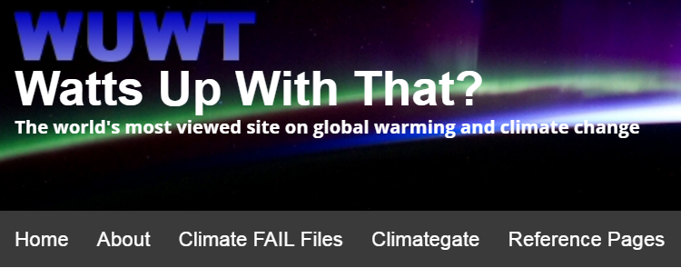
The Climate Change Dichotomy
Believers Vs Skeptics
Climate change believers insist that human activities are a primary cause of global climate change
Climate change skeptics insist that little to no evidence exists that human activities are causing climate change

Slide 8
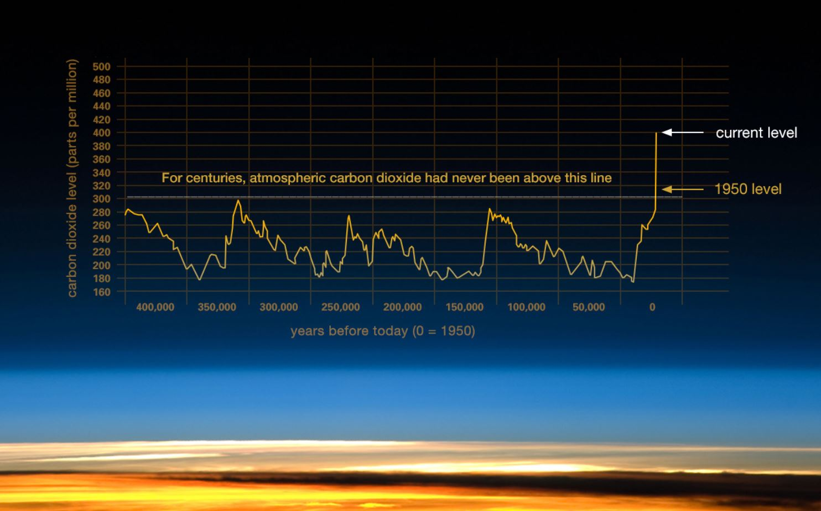
The Climate Change Driver Is CO2

Slide 9
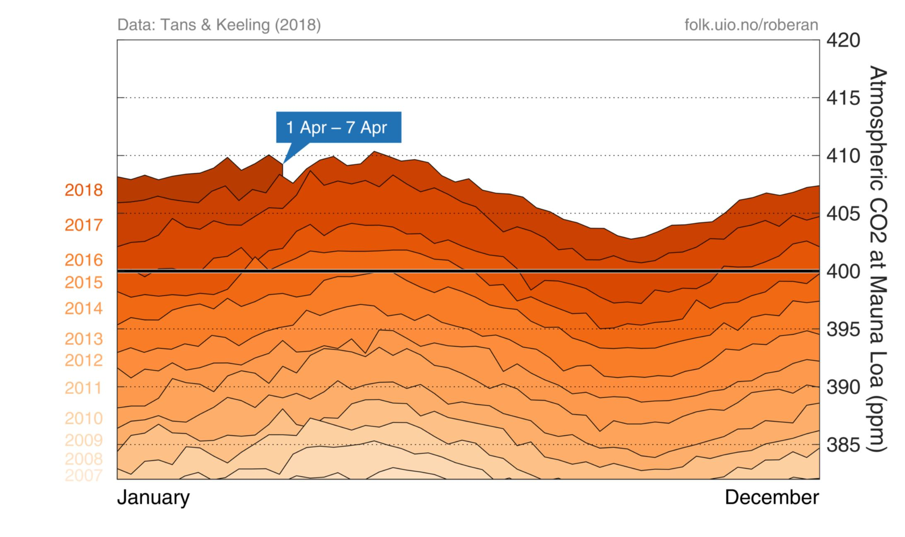
The Climate Change Driver Is CO2

Slide 10
Global Warming Indicators
Global temperature rise
Shrinking ice sheets
Glacial retreat
Melting permafrost
Decreased snow cover
Declining Arctic sea ice
Warming oceans
Ocean acidification
Sea level rise
Extreme events increasing

Slide 11
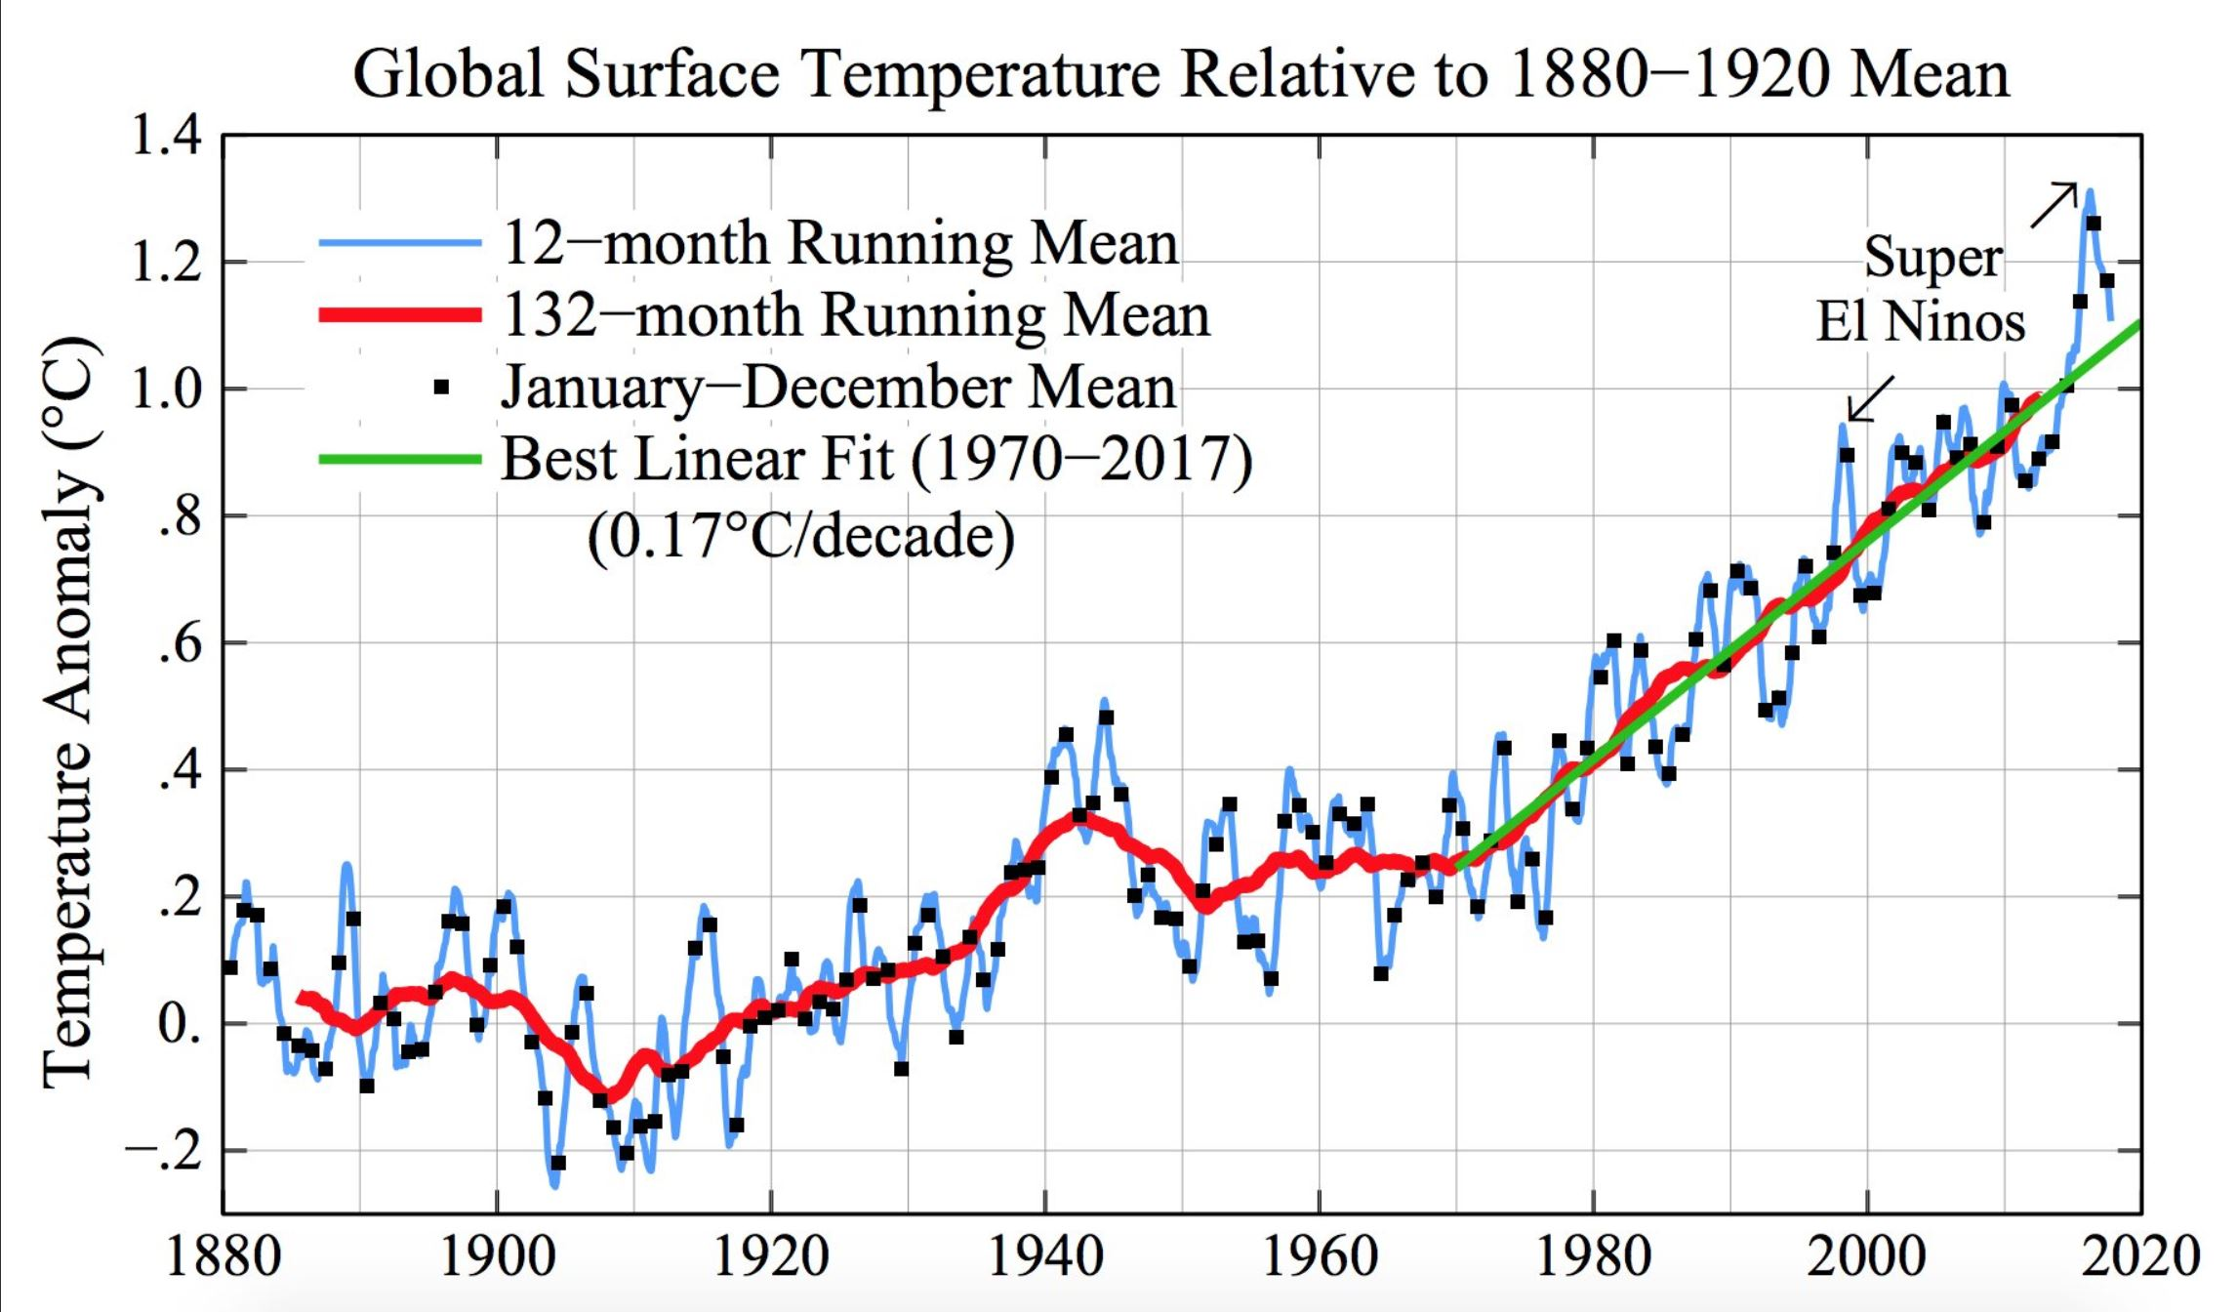
1 - Global Temperature Rise

Slide 12
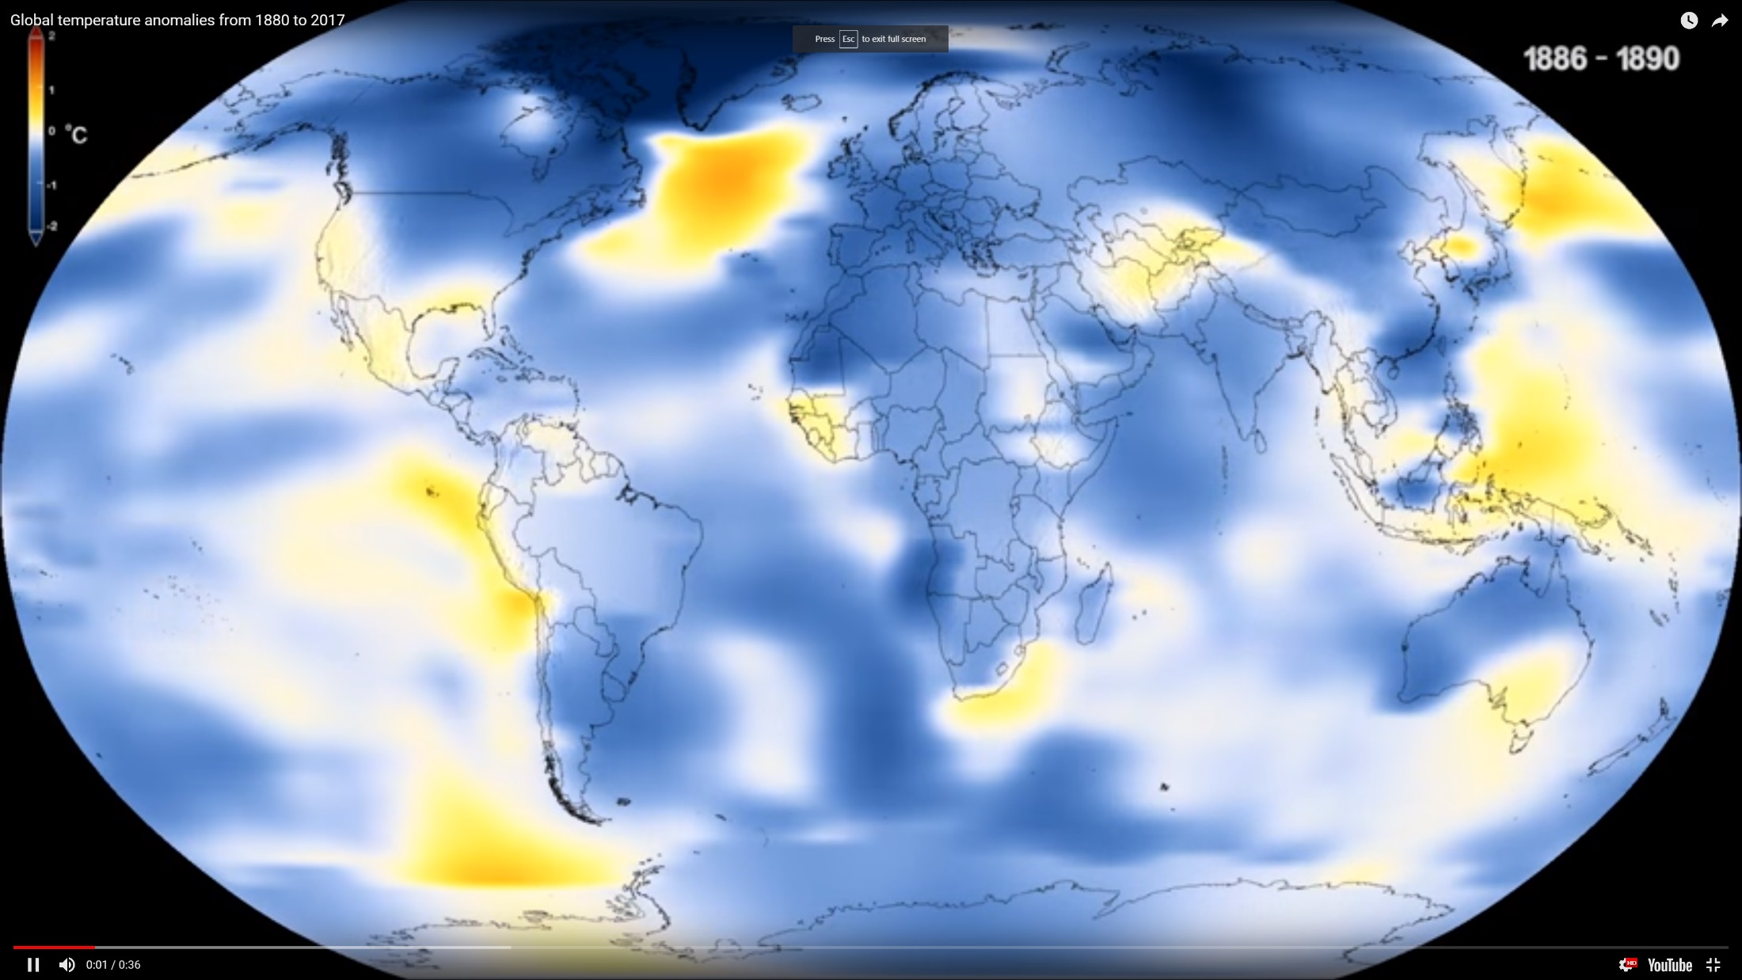
1 - Global Temperature Rise

Slide 13
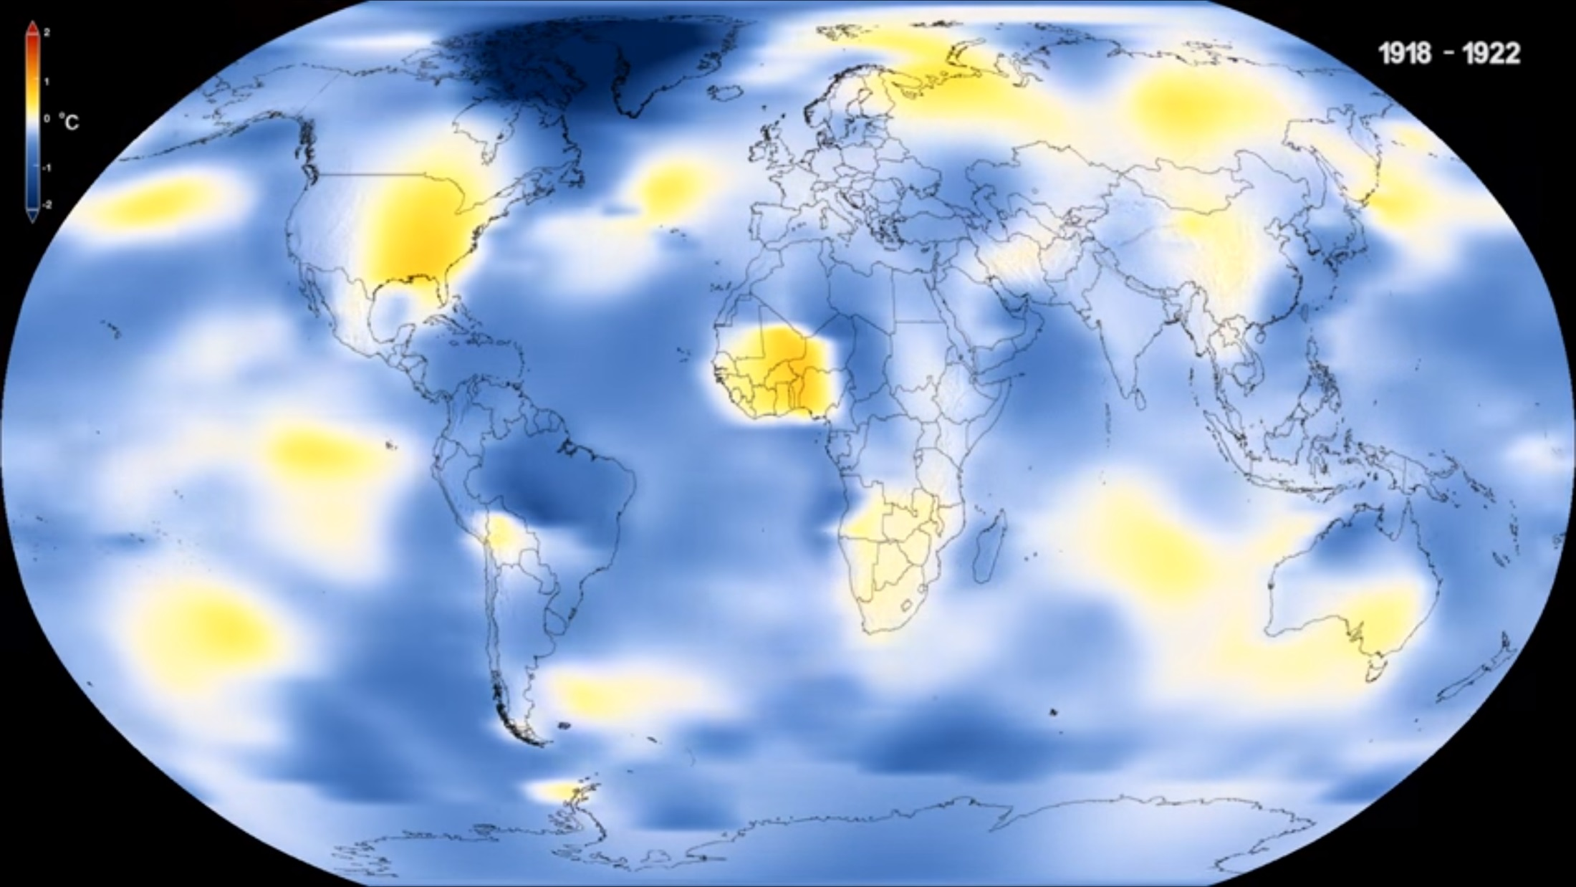
1 - Global Temperature Rise

Slide 14
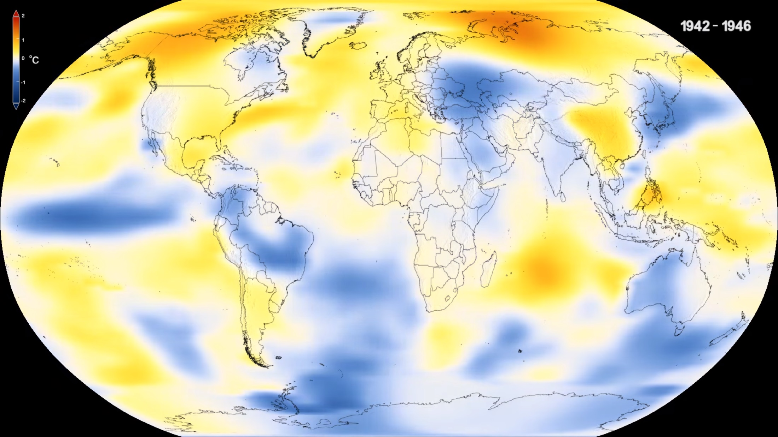
1 - Global Temperature Rise

Slide 15
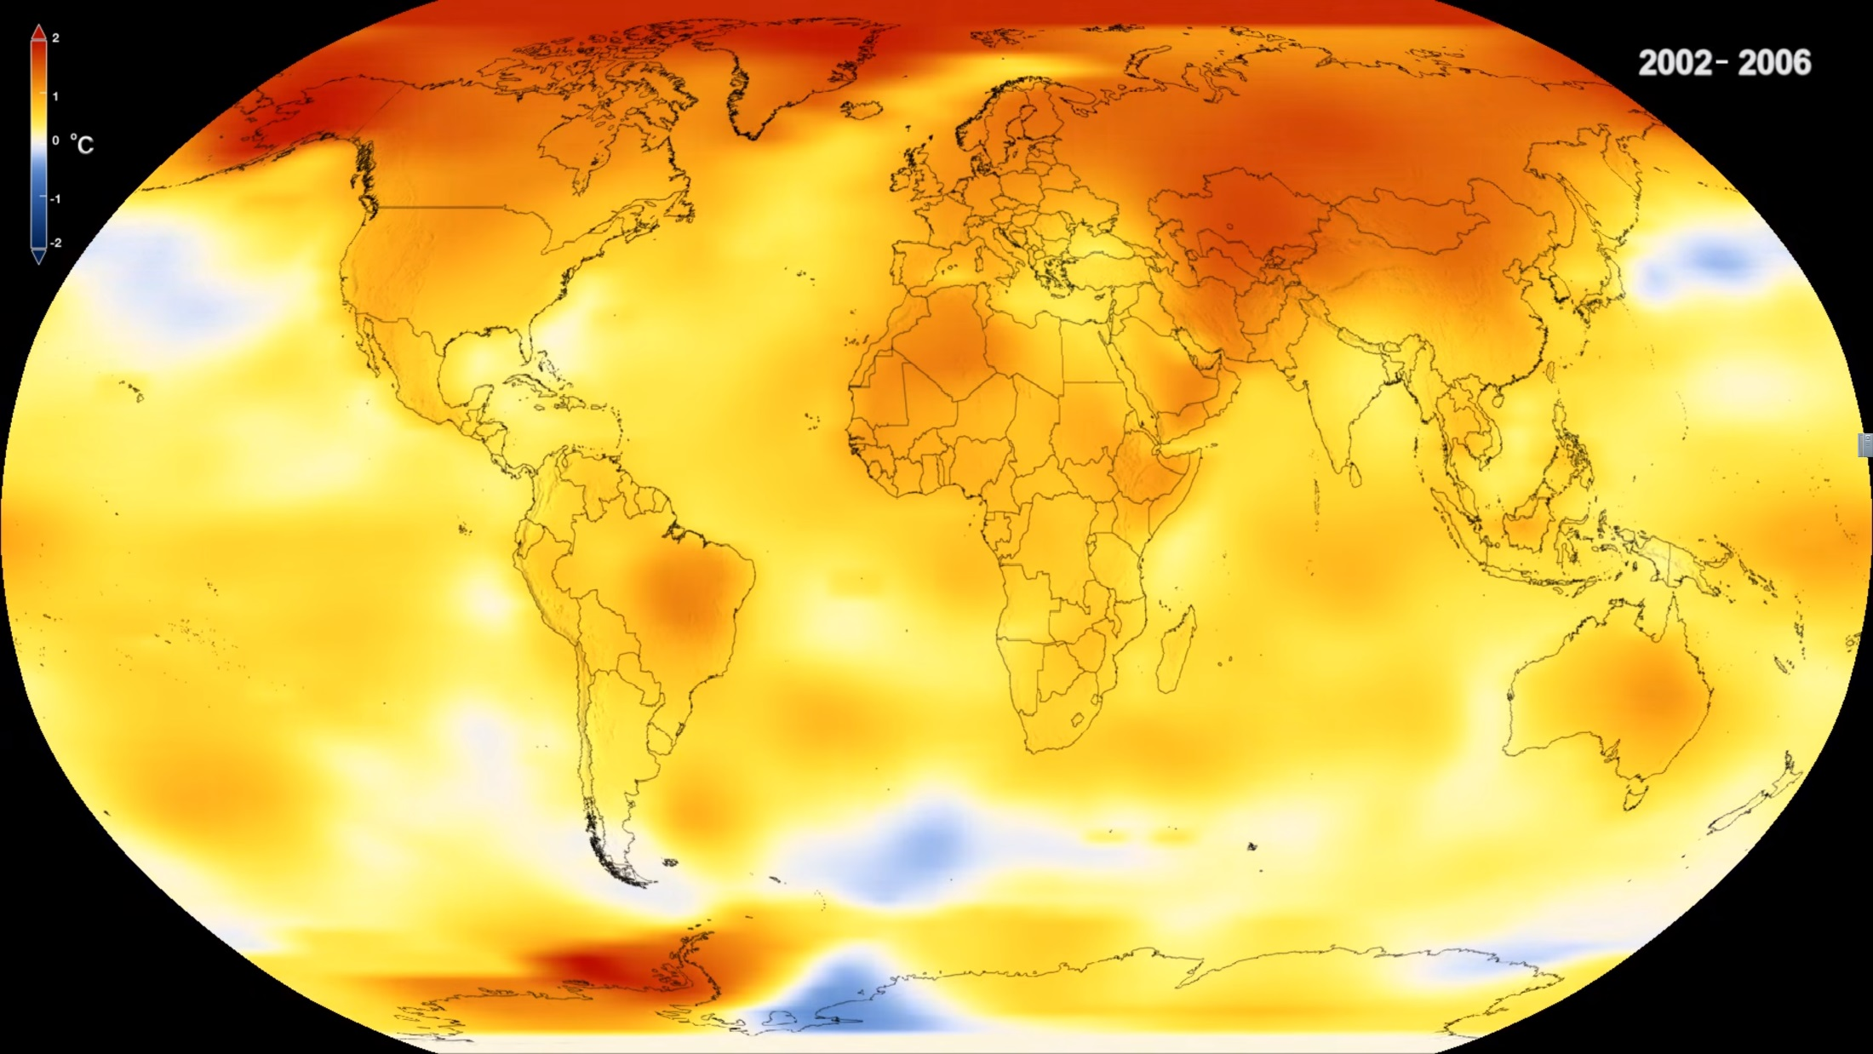
1 - Global Temperature Rise

Slide 16
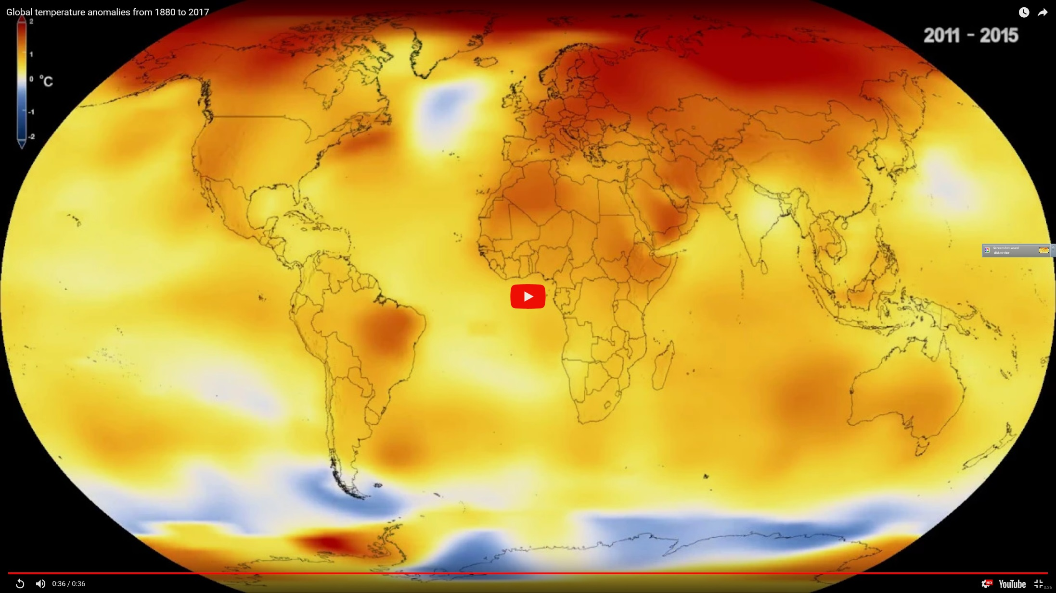
1 - Global Temperature Rise

Slide 17
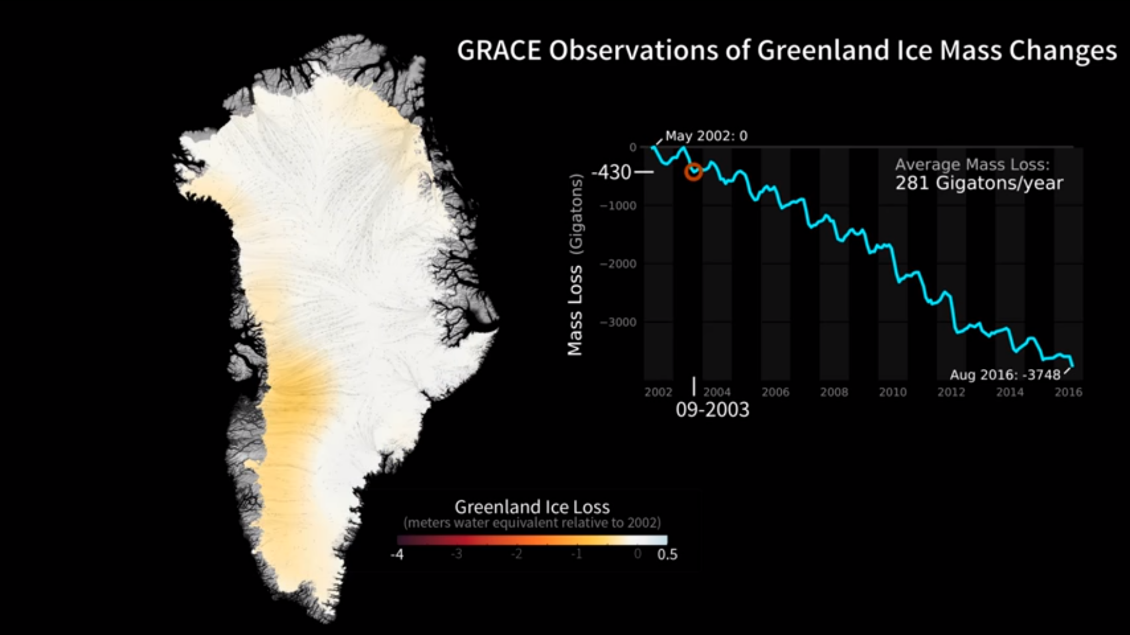
2 – Shrinking Ice Sheets - Greenland

Slide 18
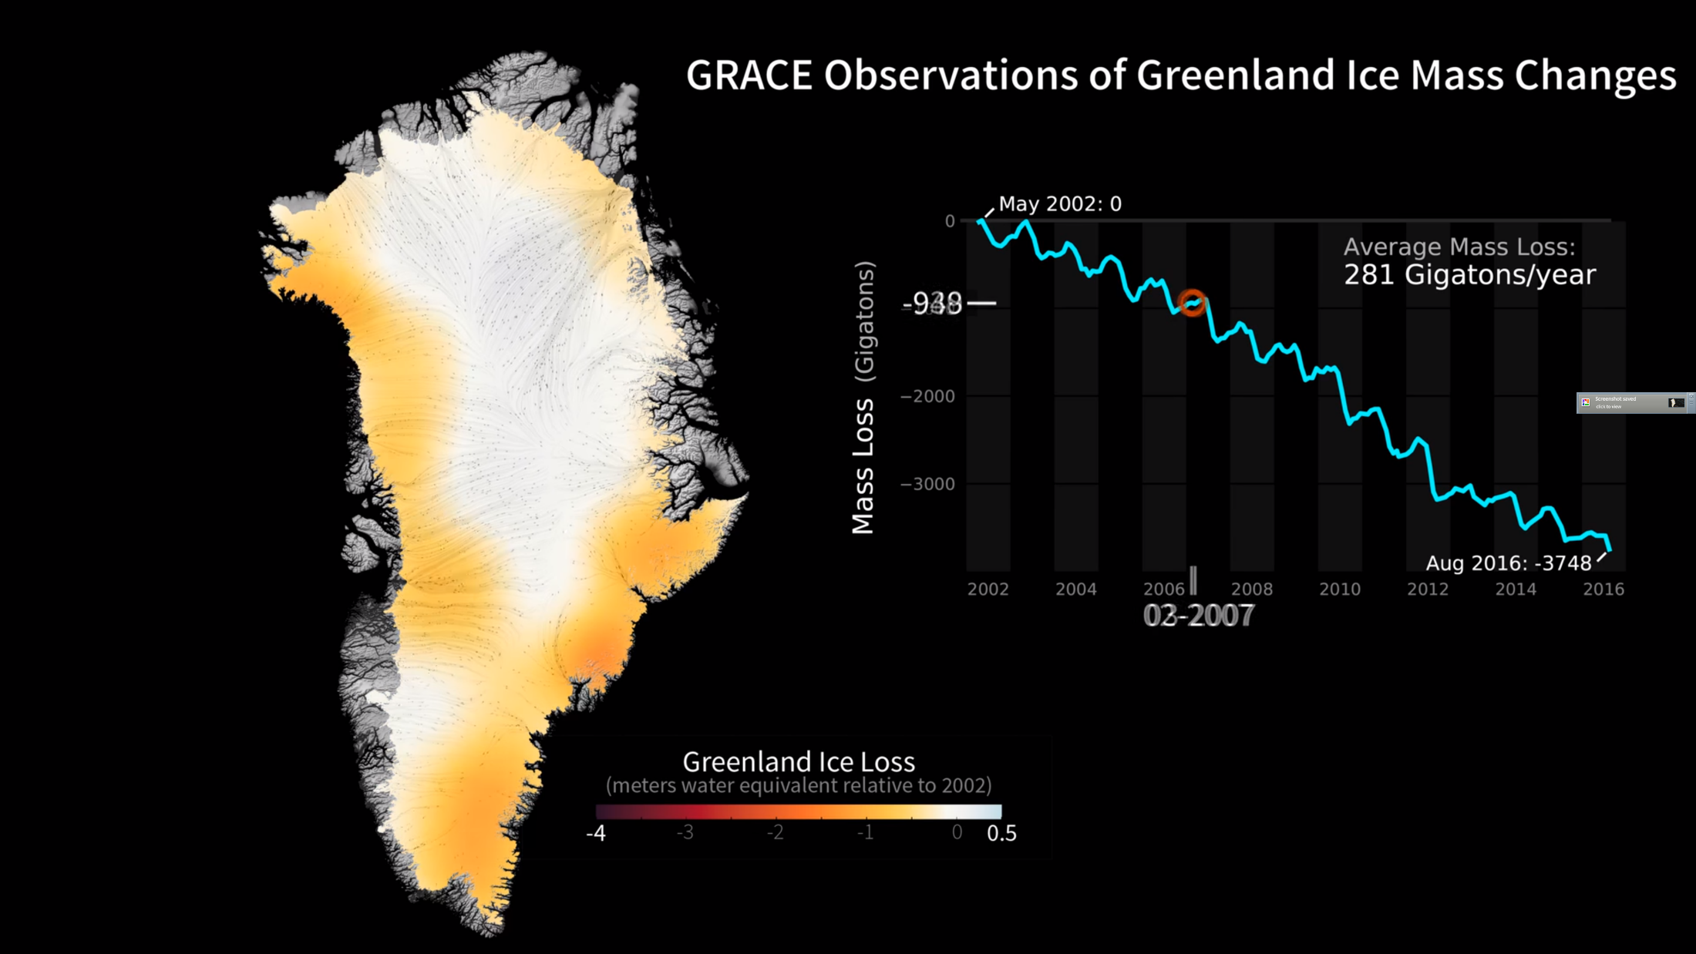
2 – Shrinking Ice Sheets - Greenland

Slide 19
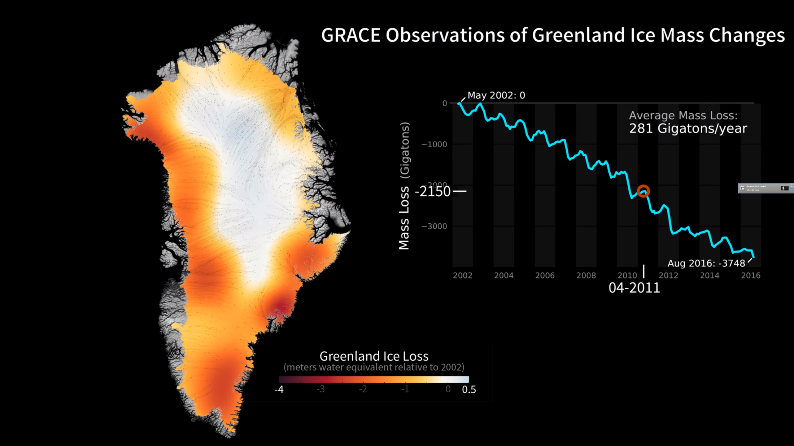
2 – Shrinking Ice Sheets - Greenland

Slide 20
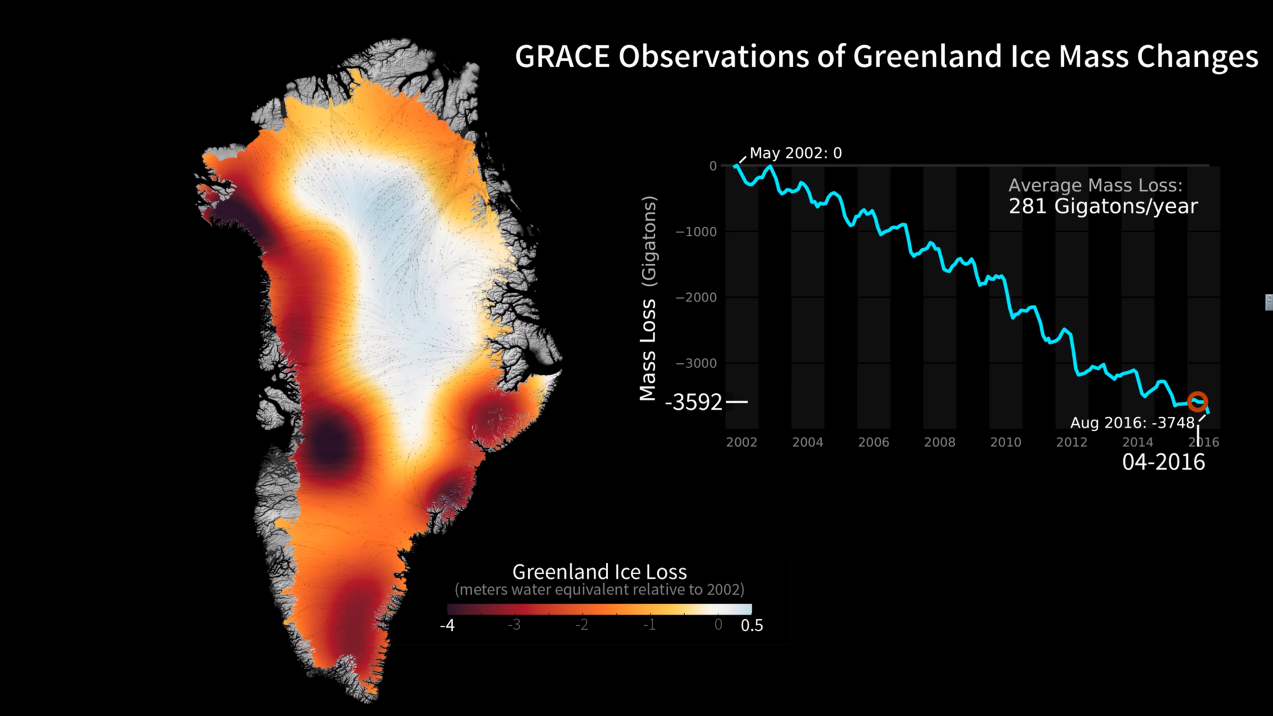
2 – Shrinking Ice Sheets - Greenland

Slide 21
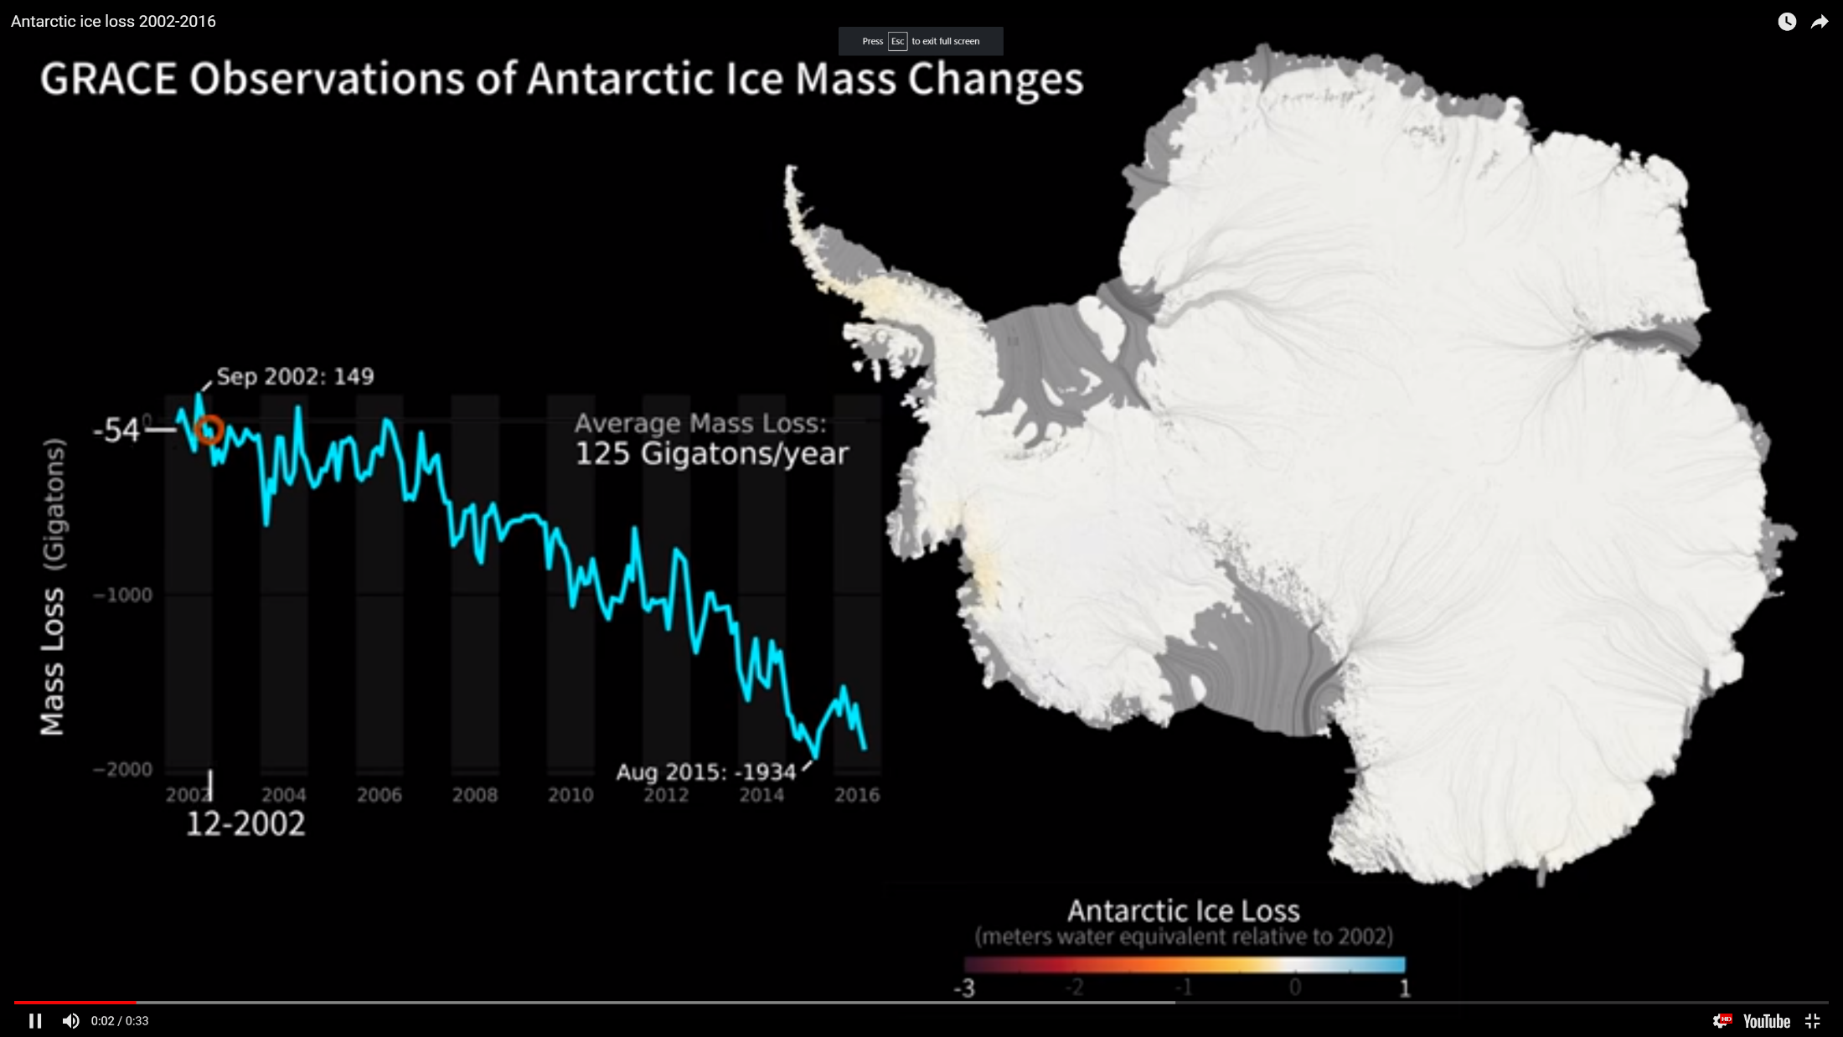
2 – Shrinking Ice Sheets - Antarctica

Slide 22
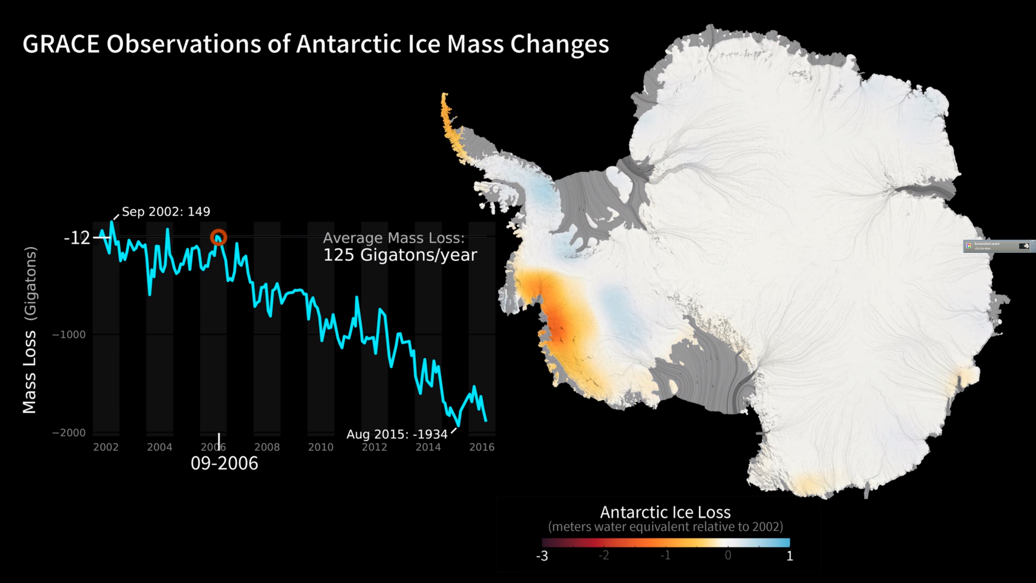
2 – Shrinking Ice Sheets - Antarctica

Slide 23
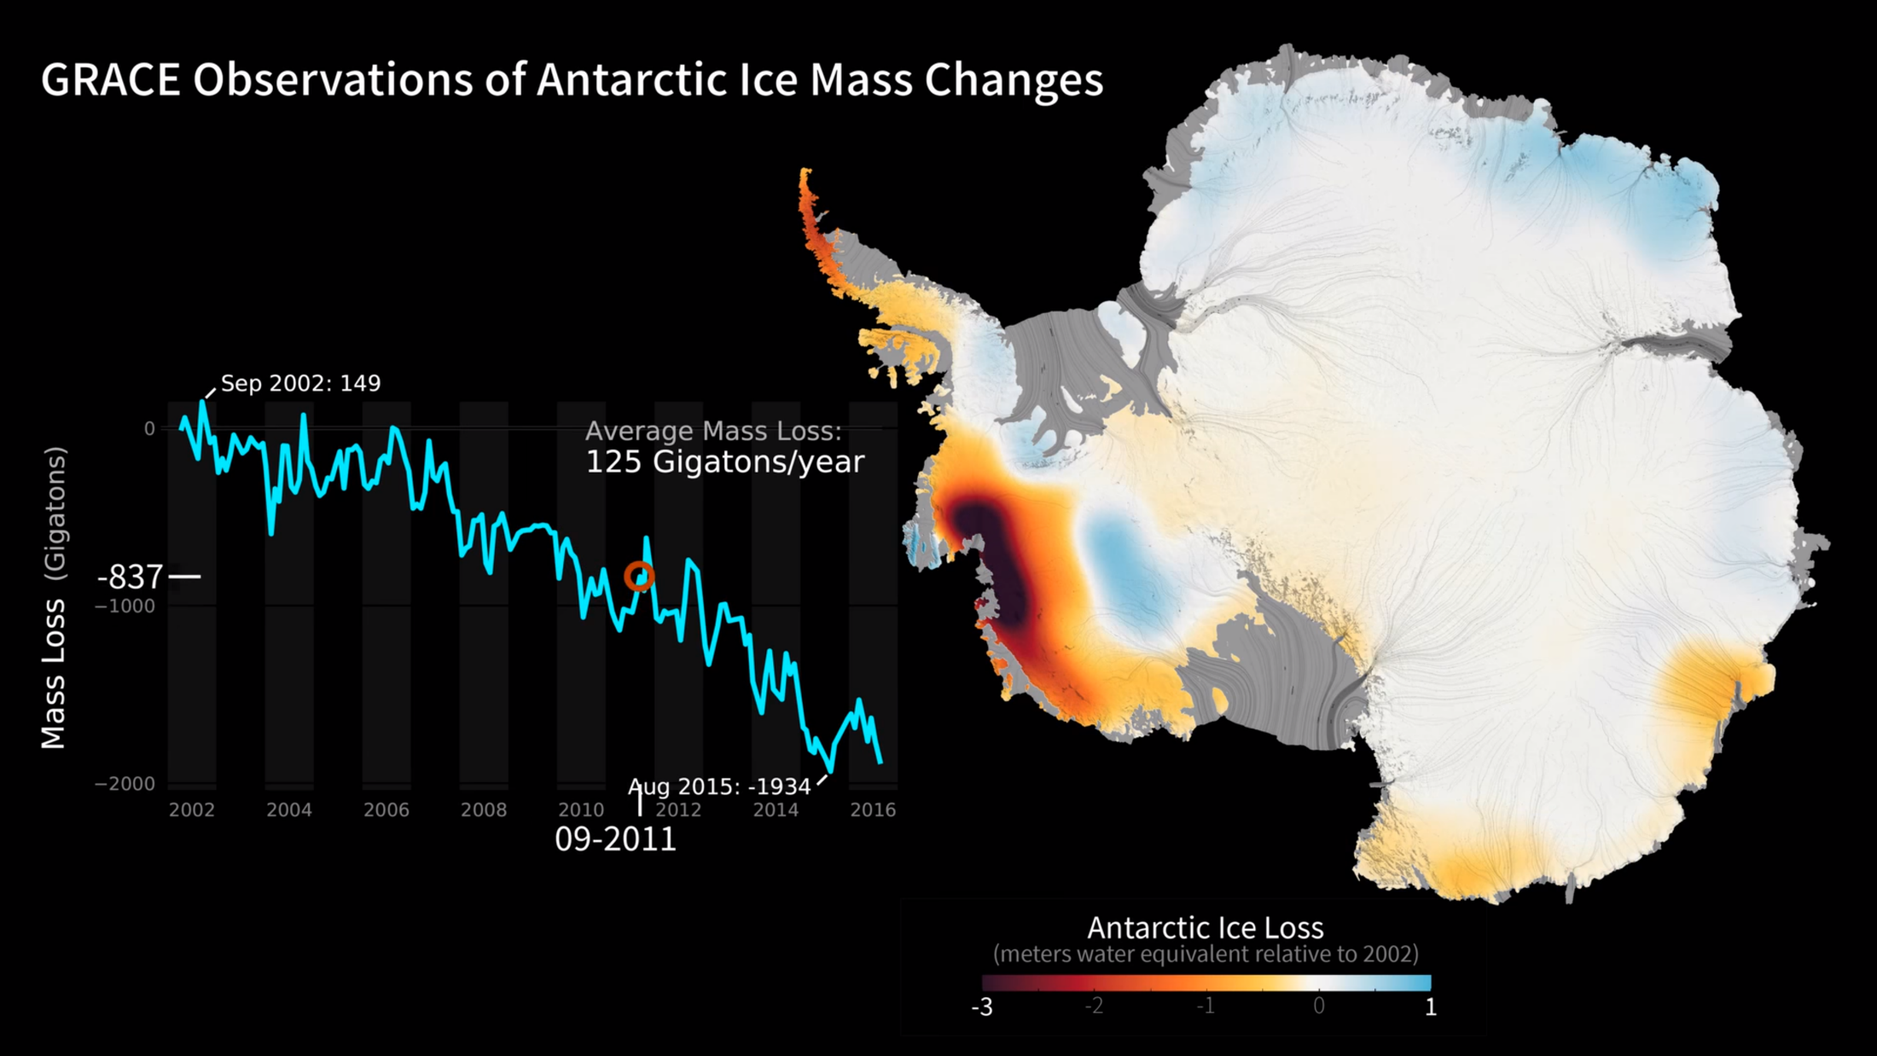
2 – Shrinking Ice Sheets - Antarctica

Slide 24
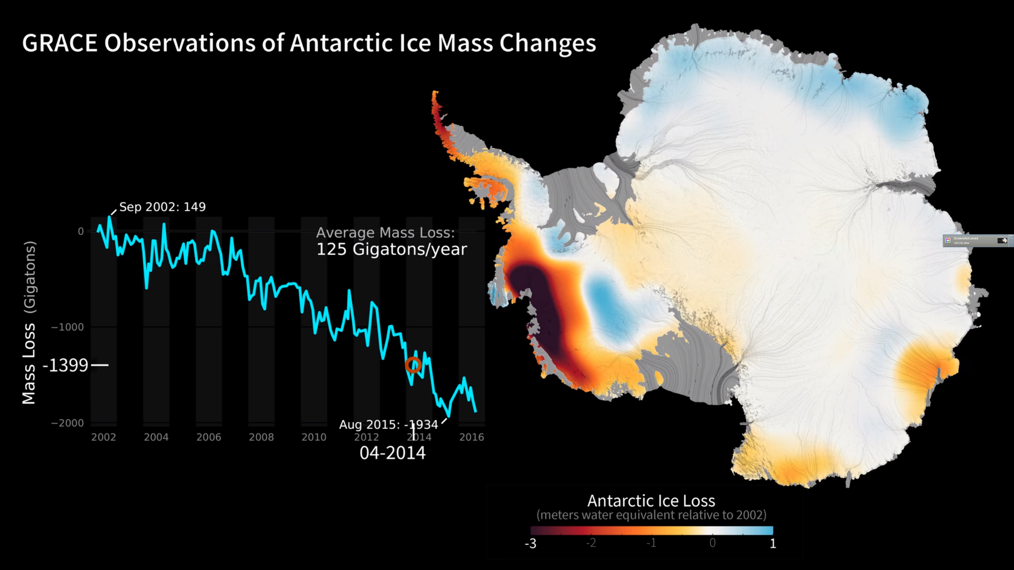
2 – Shrinking Ice Sheets - Antarctica

Slide 25
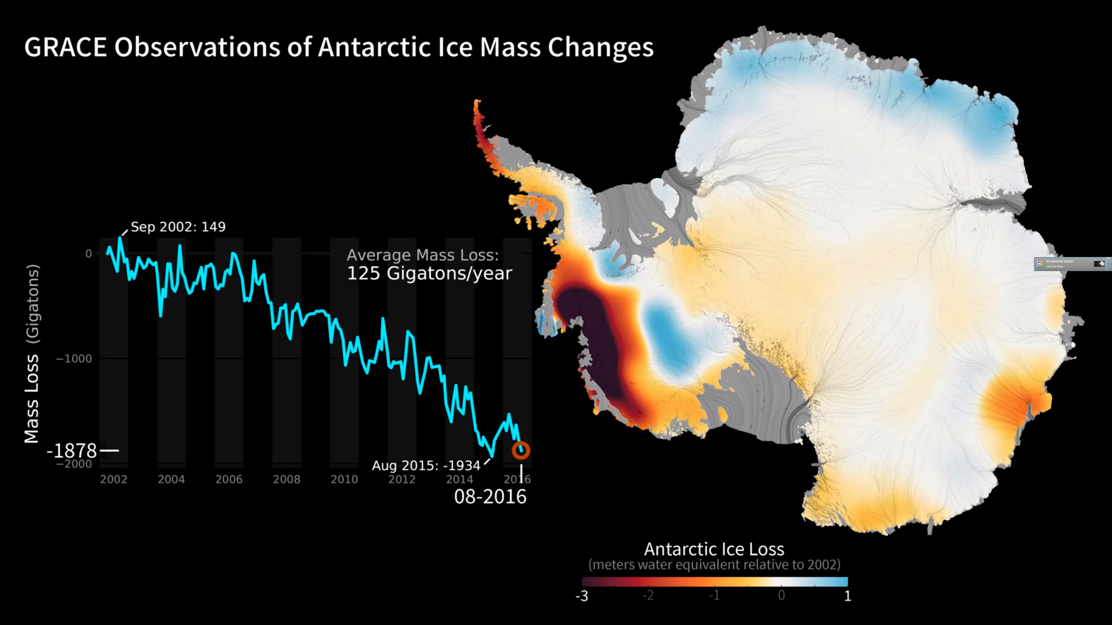
2 – Shrinking Ice Sheets - Antarctica

Slide 26
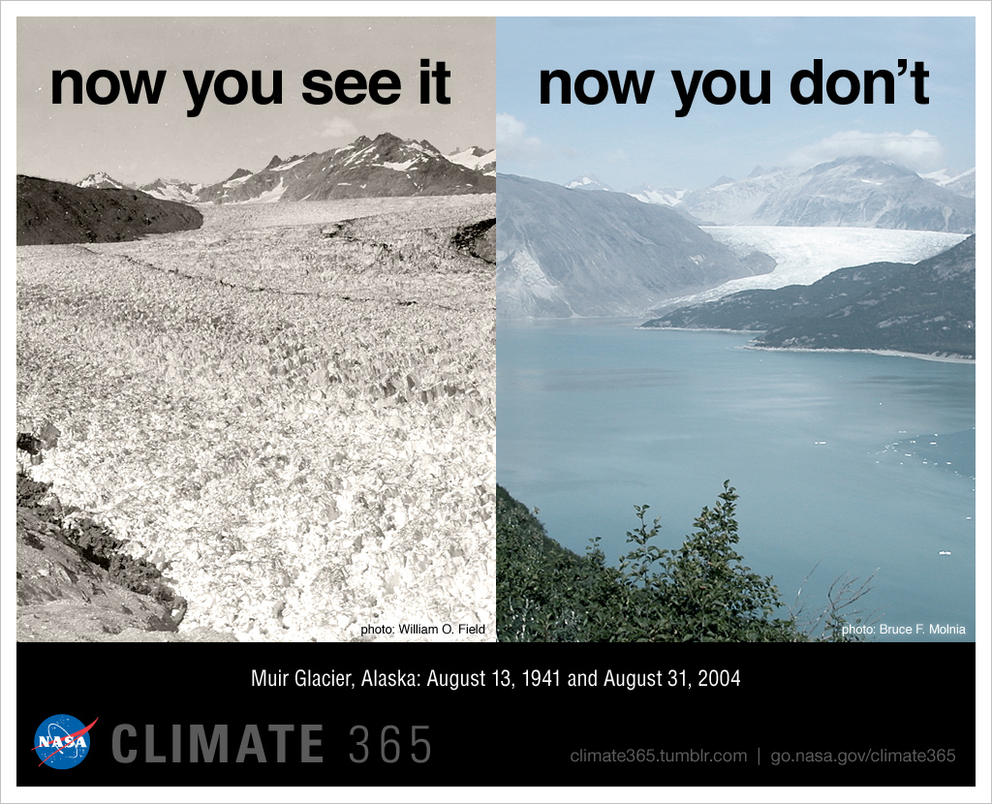
3 – Glacial Retreat - Alaska

Slide 27
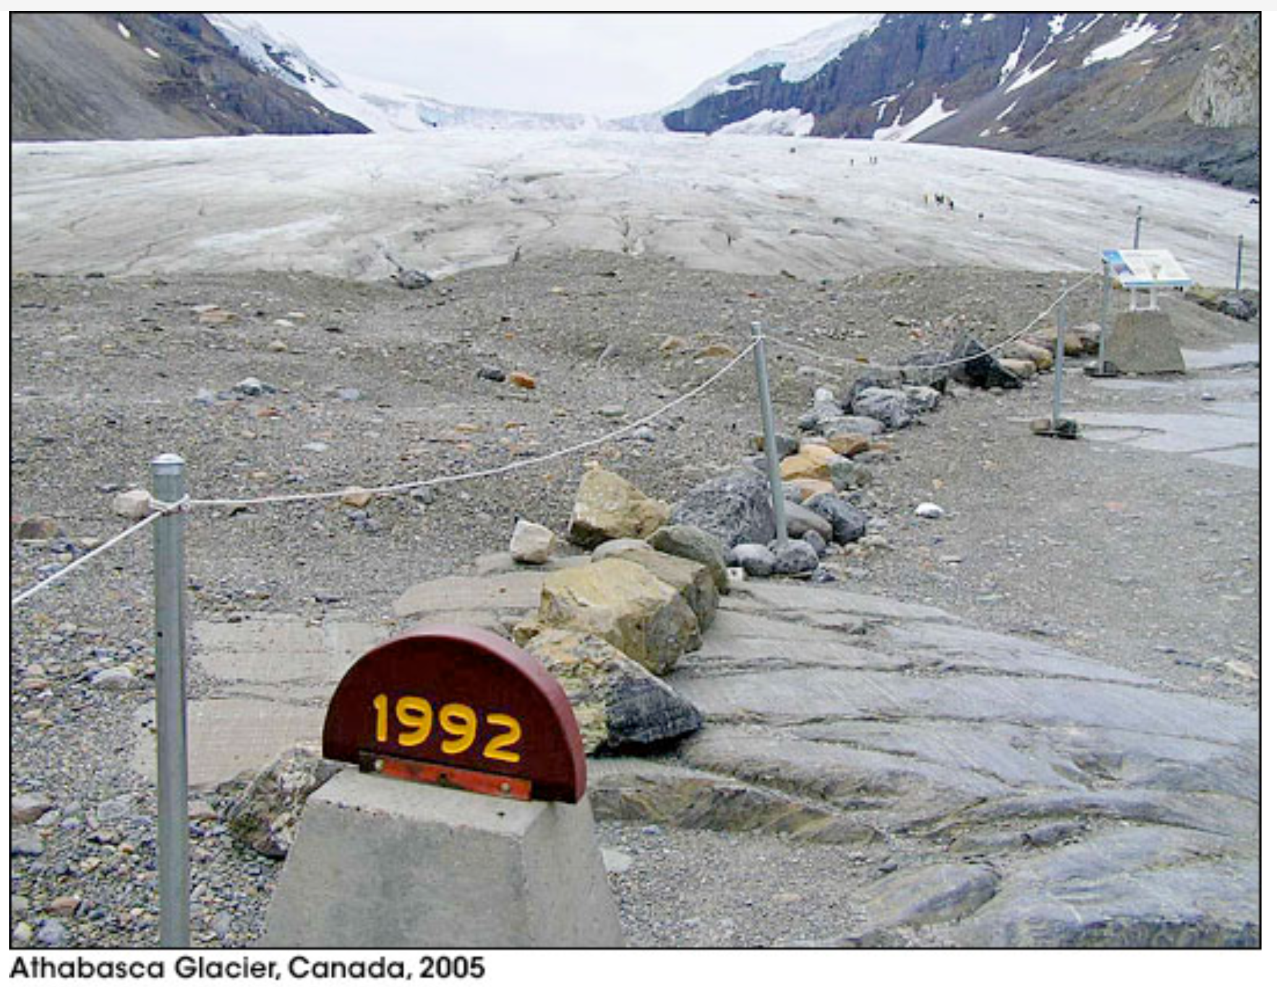
3 – Glacial Retreat - Canada

Slide 28
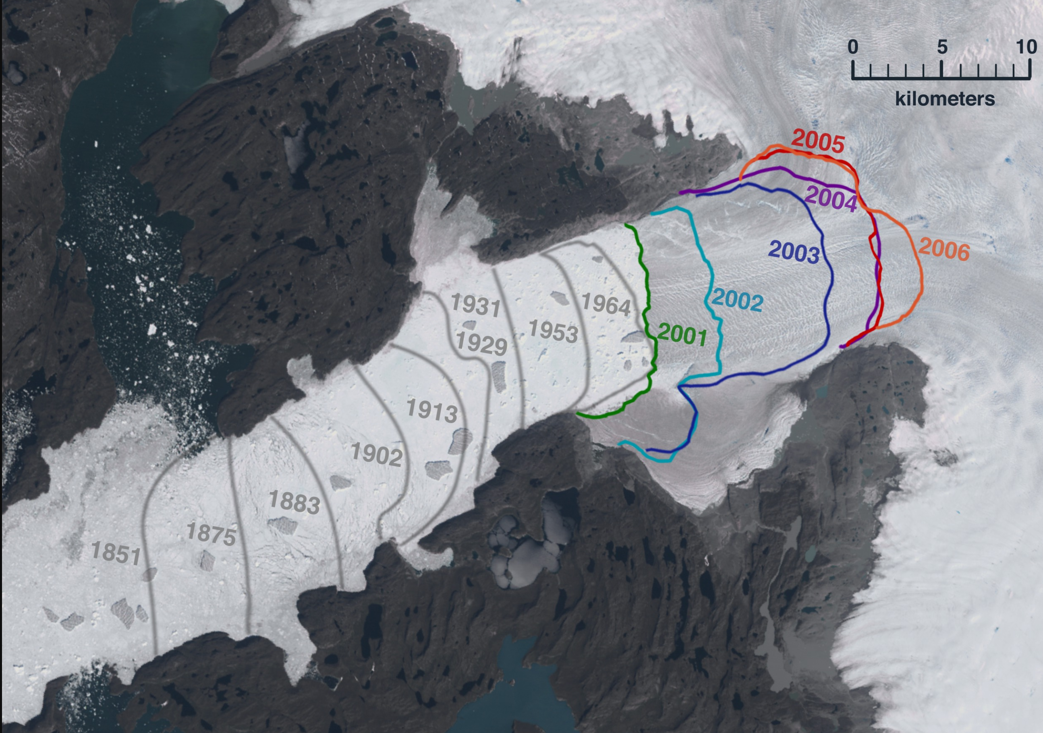
3 – Glacial Retreat - Greenland

Slide 29
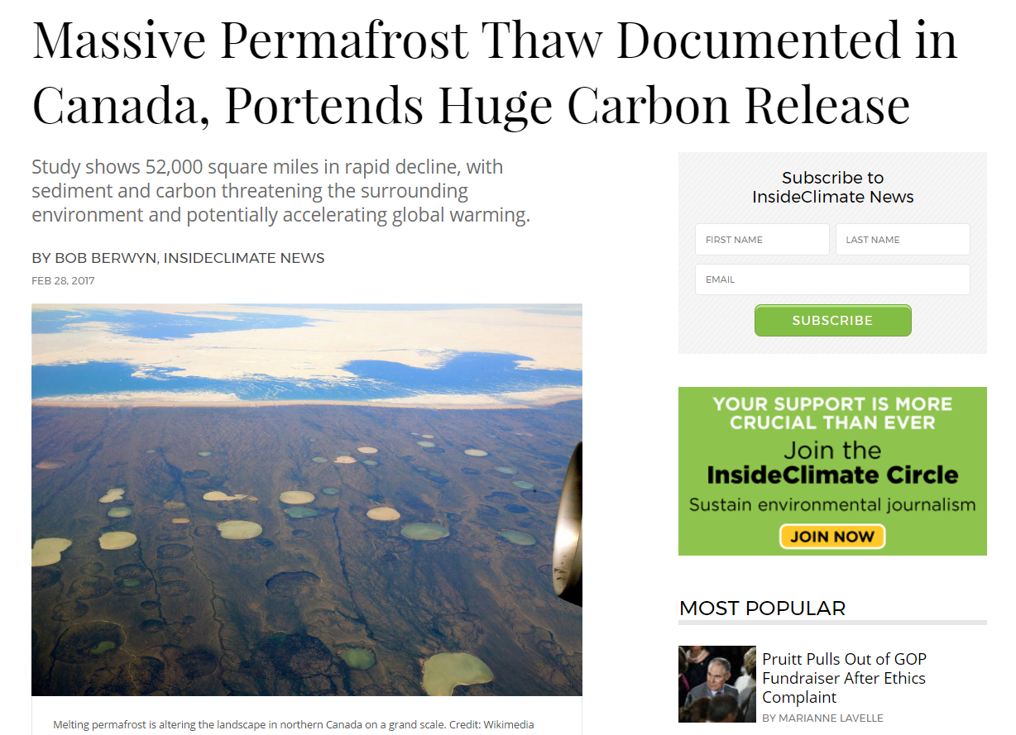
4 – Melting Permafrost

Slide 30
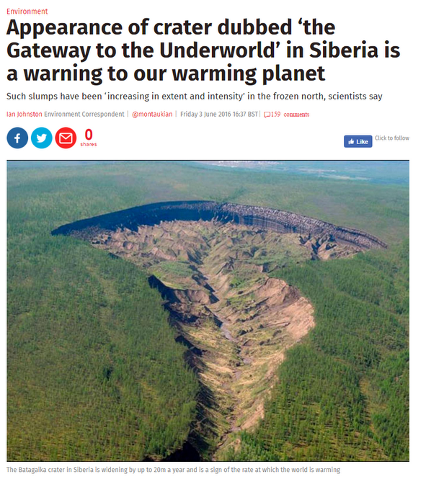
4 – Melting Permafrost

Slide 31
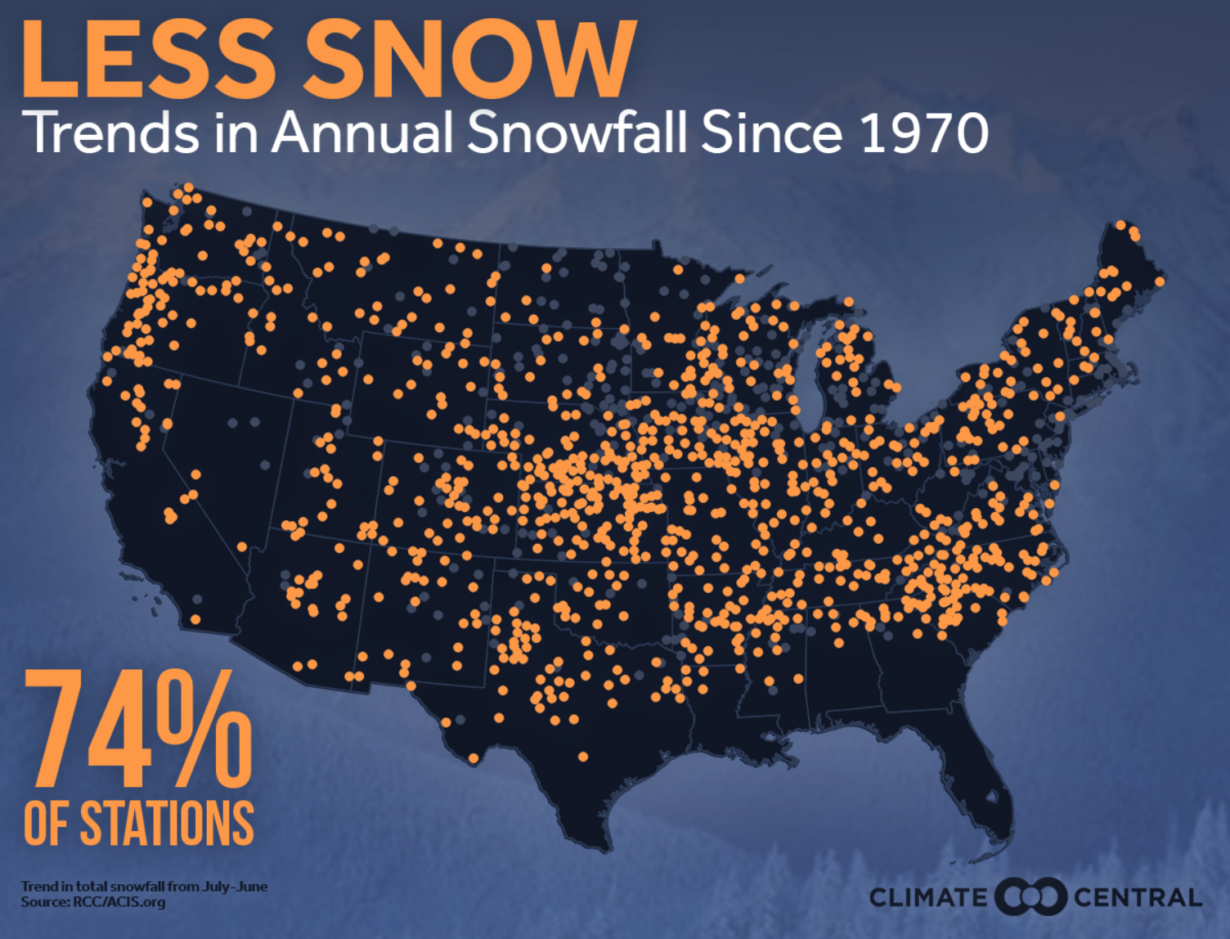
5 – Decreased Snow Cover

Slide 32
5 – Decreased Snow Cover

Slide 33
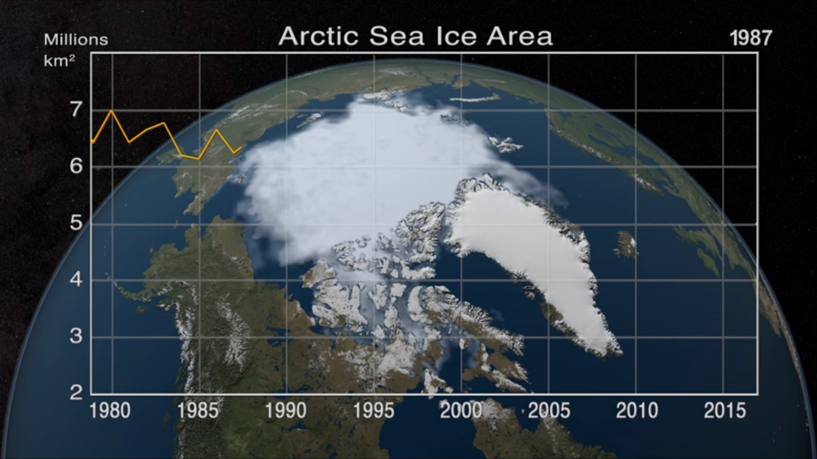
6 – Declining Arctic Sea Ice

Slide 34
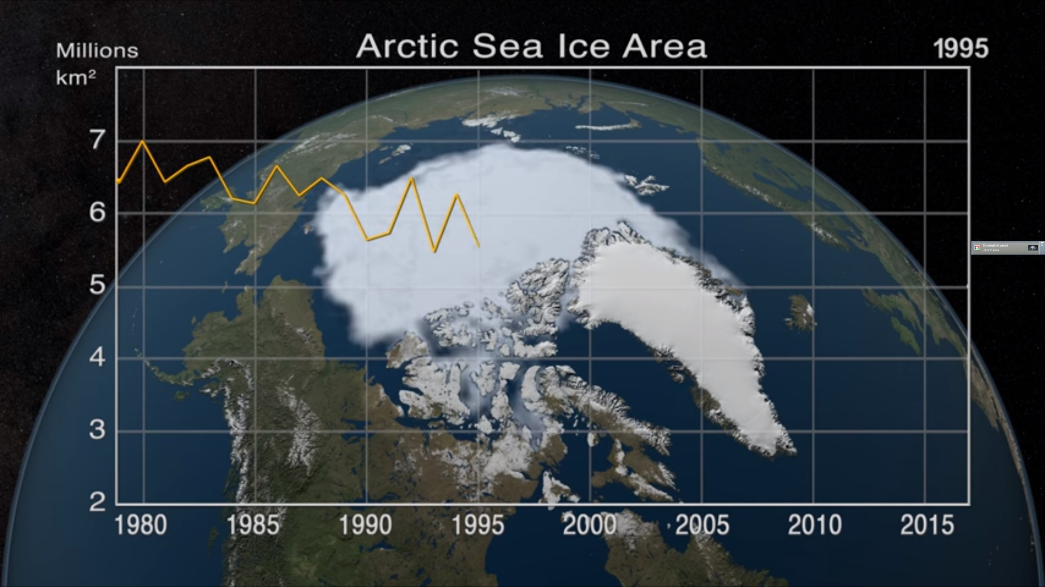
6 – Declining Arctic Sea Ice

Slide 35
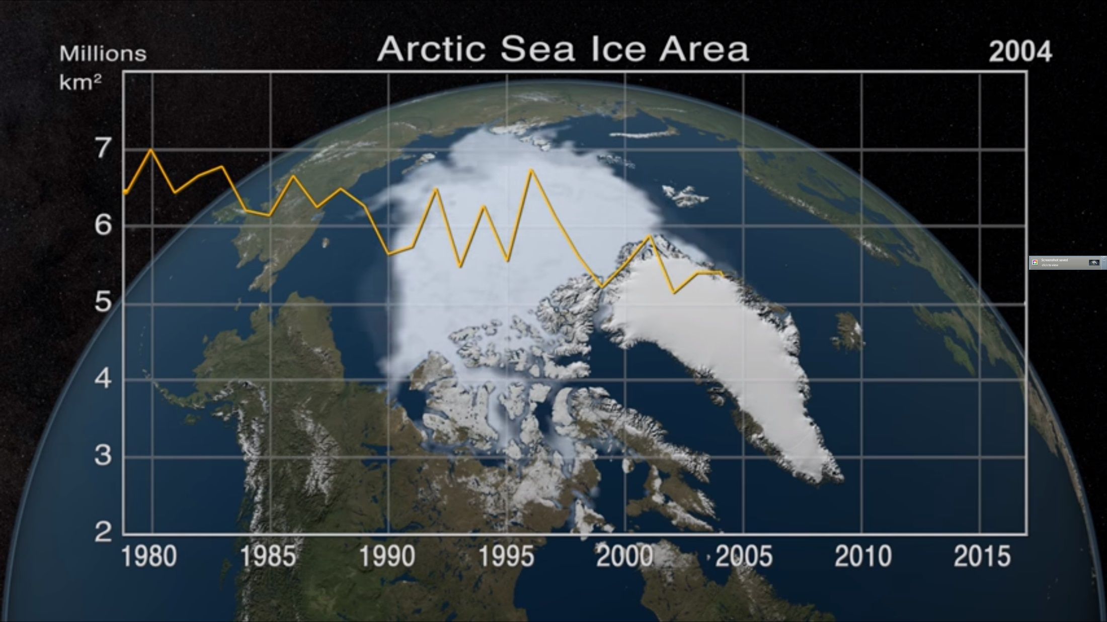
6 – Declining Arctic Sea Ice

Slide 36
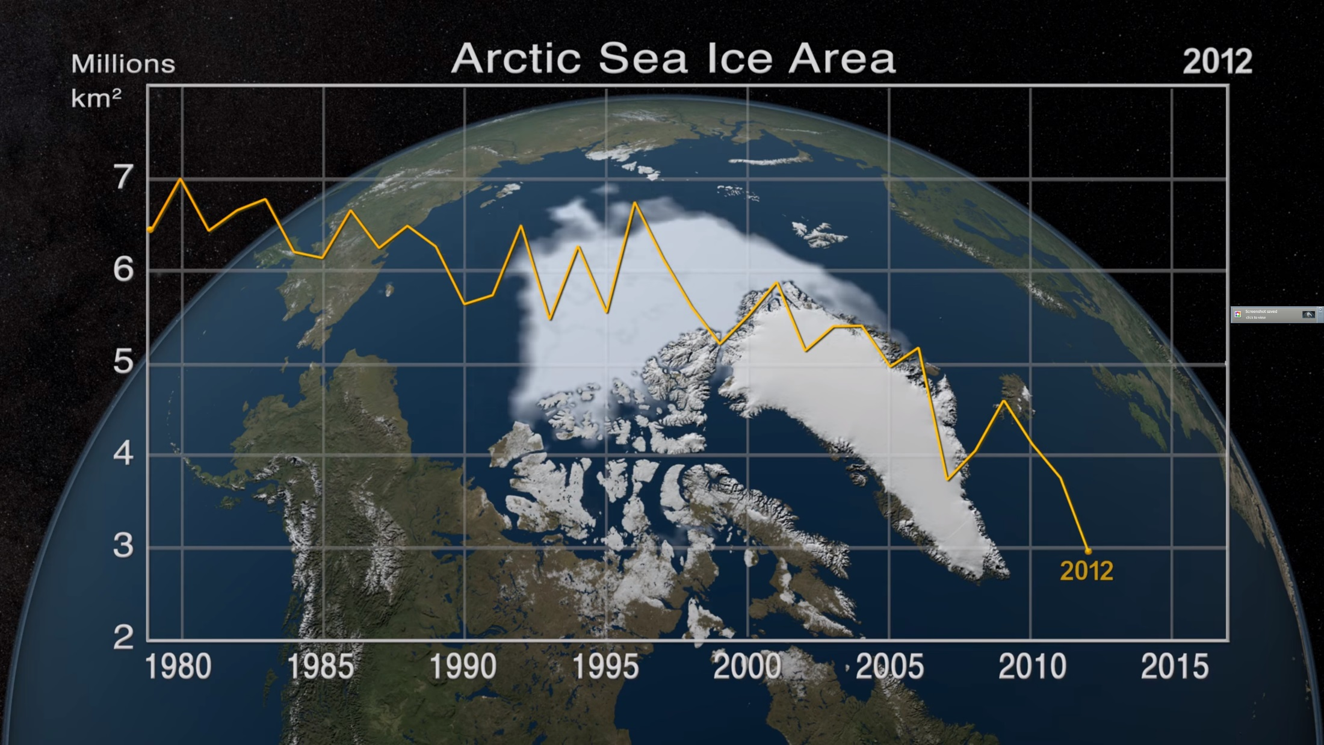
6 – Declining Arctic Sea Ice

Slide 37
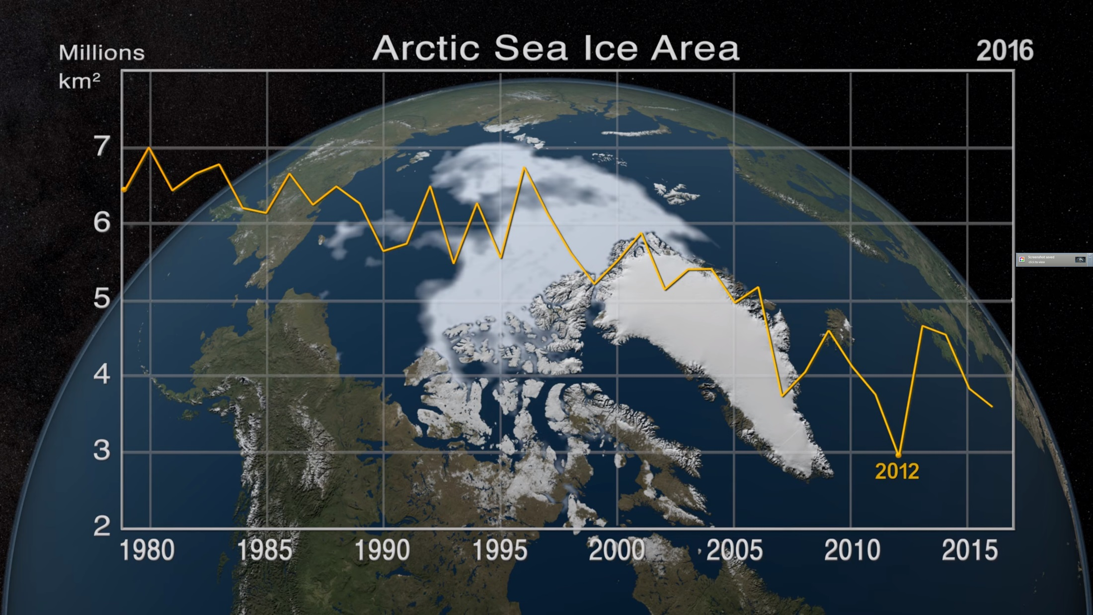
6 – Declining Arctic Sea Ice

Slide 38
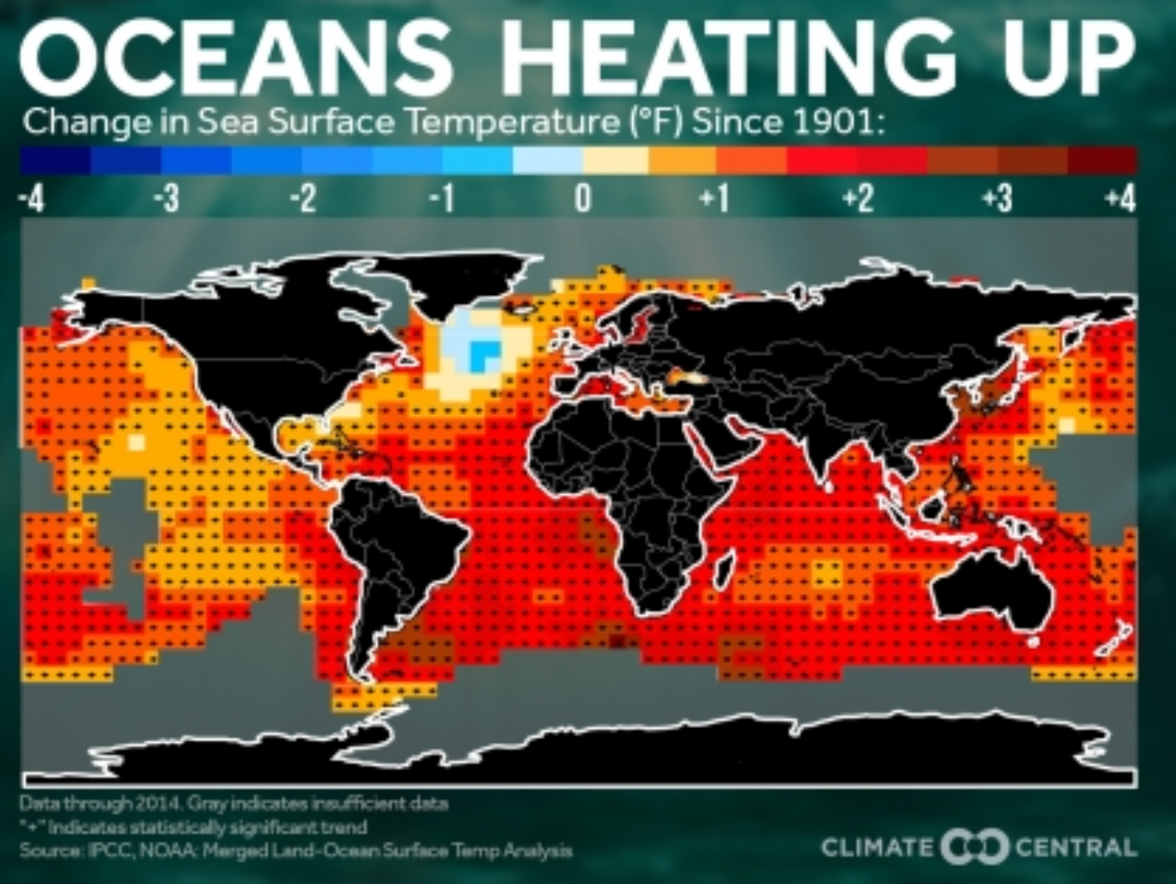
7 – Warming Oceans

Slide 39
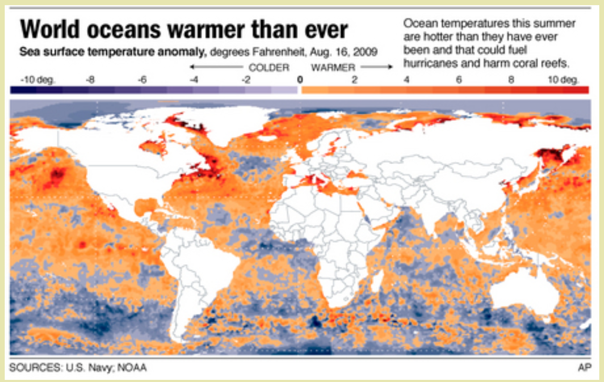
7 – Warming Oceans

Slide 40
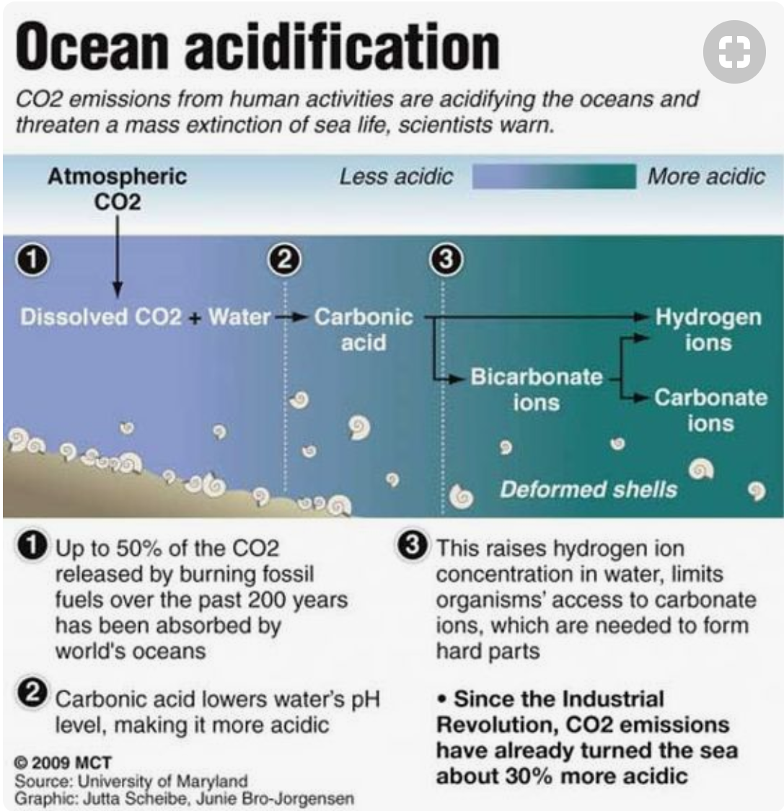
8 – Ocean Acidification

Slide 41
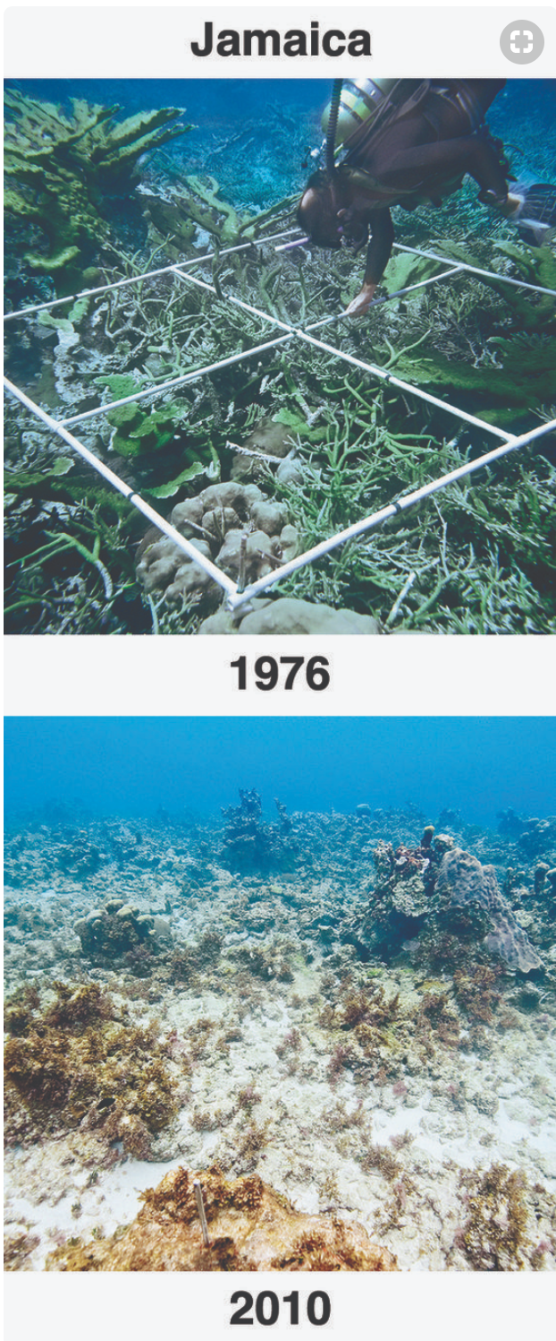
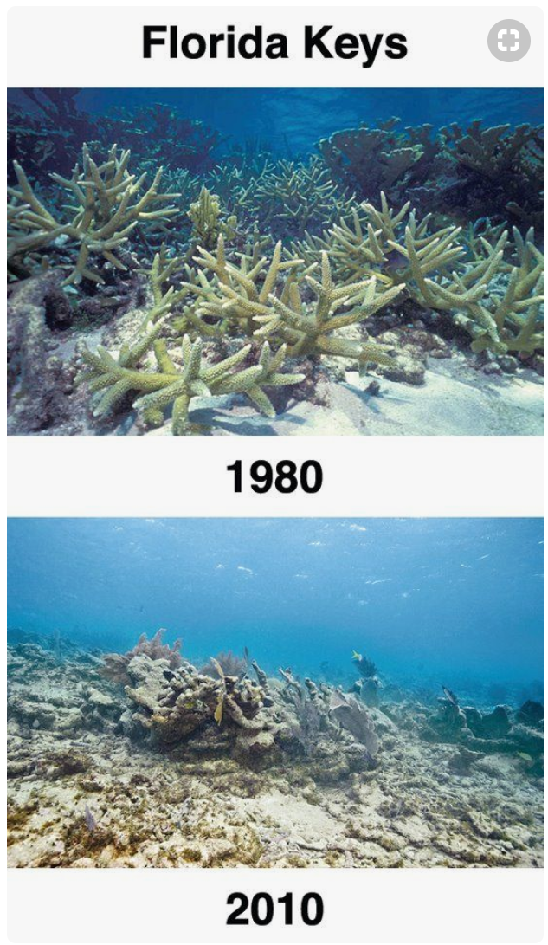
8 – Ocean Acidification

Slide 42
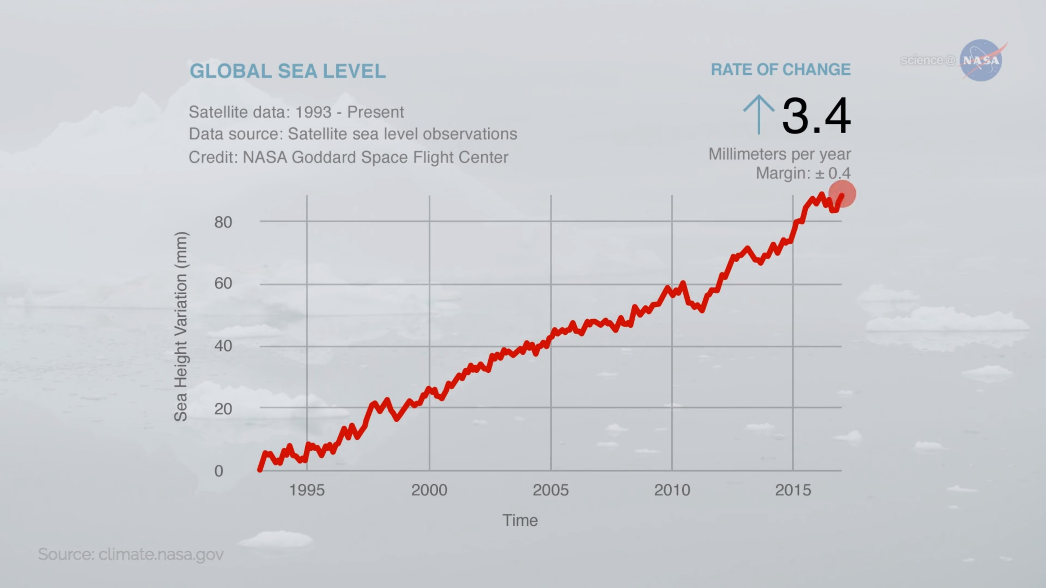
9 – Sea Level Rise

Slide 43
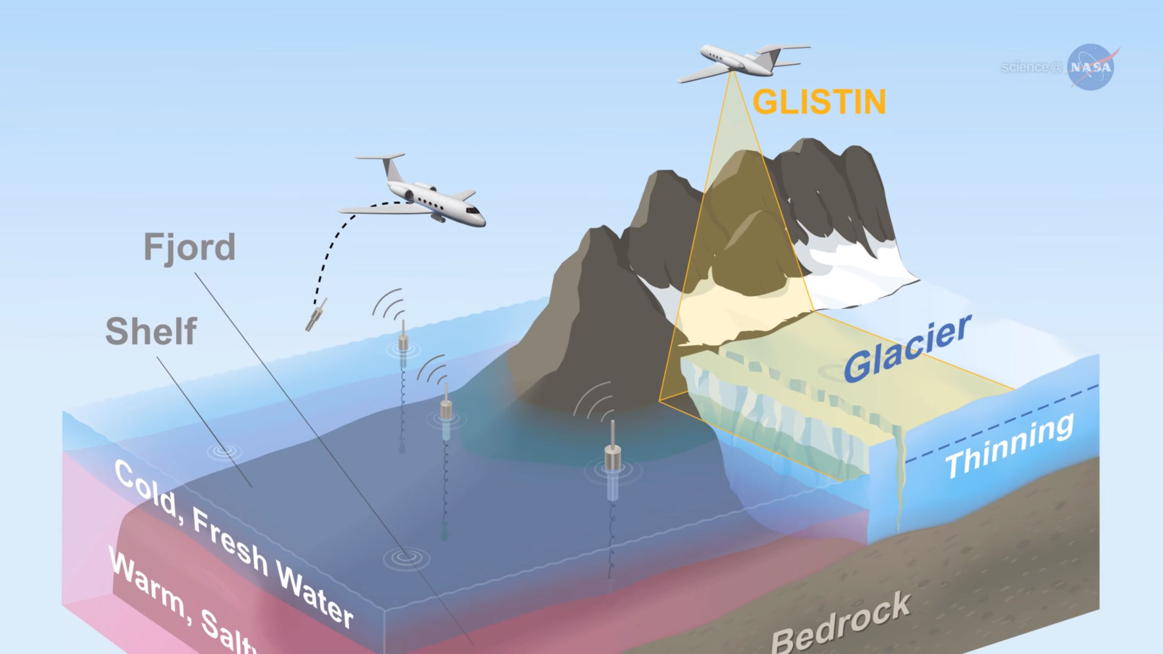
9 – Sea Level Rise

Slide 44
9 – Sea Level Rise

Slide 45
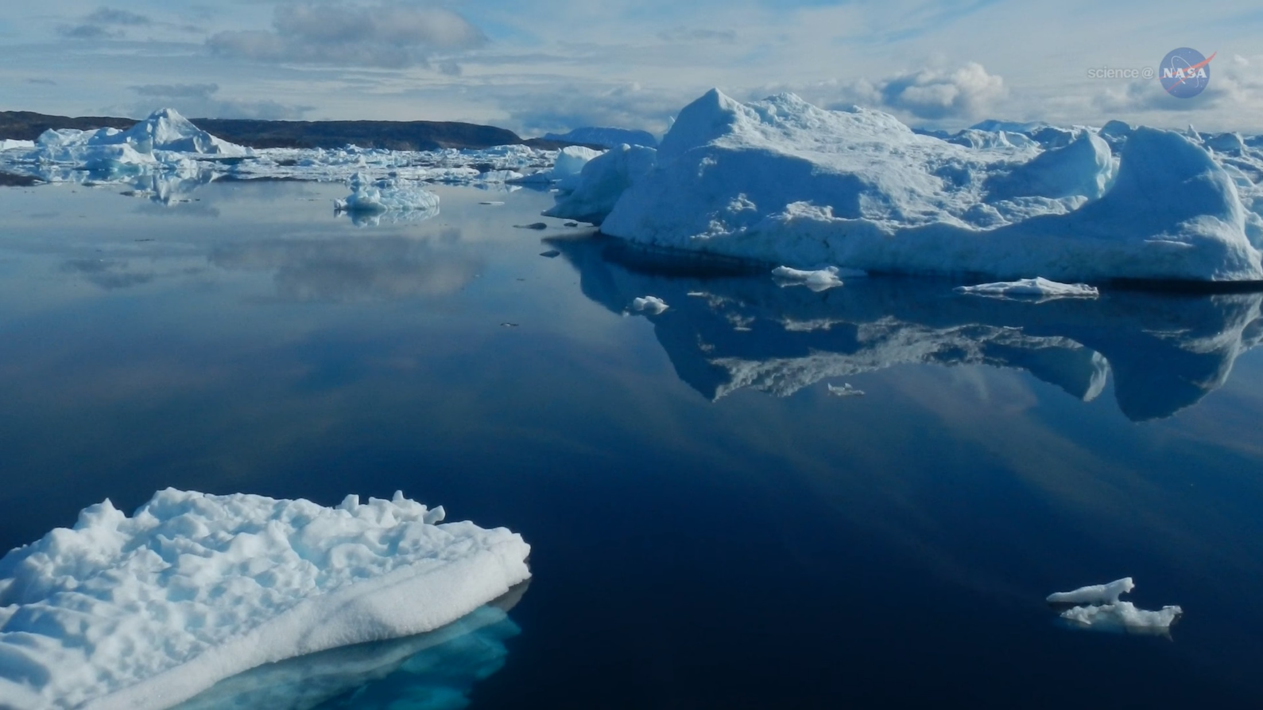
9 – Sea Level Rise

Slide 46
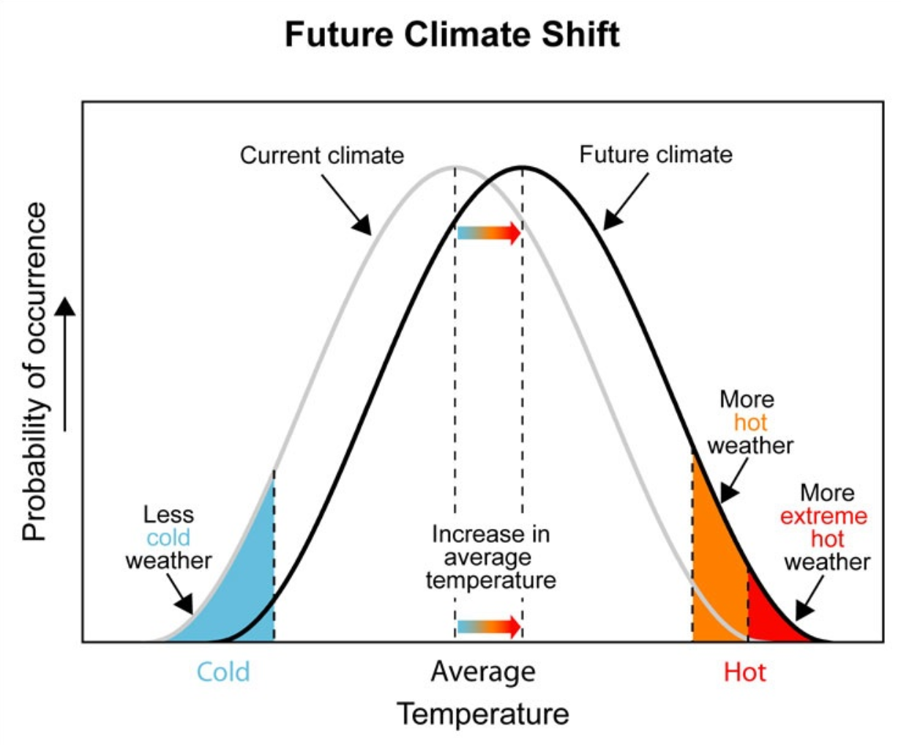
10 – Extreme Events Increasing

Slide 47
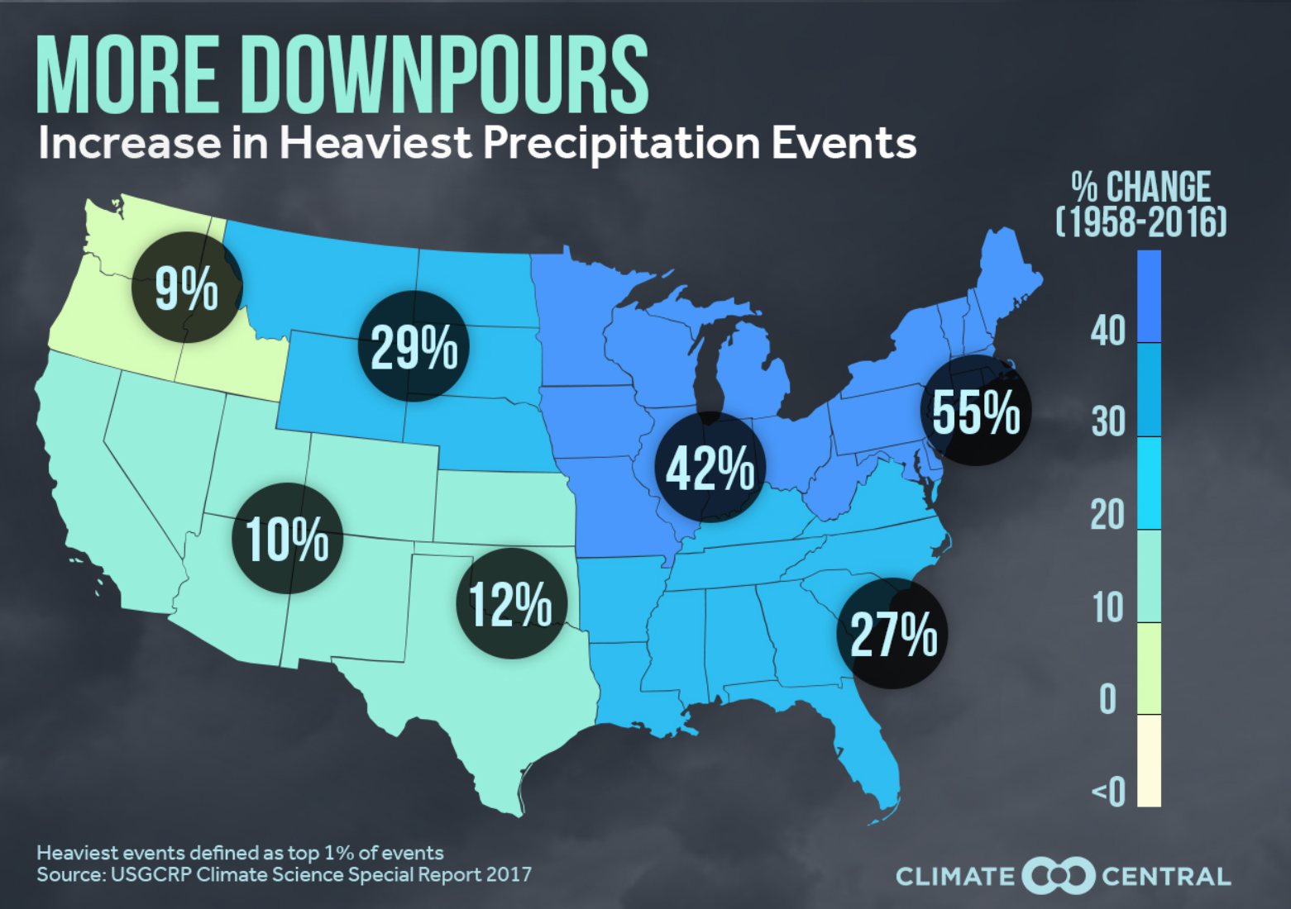
10 – Extreme Events Increasing

Slide 48
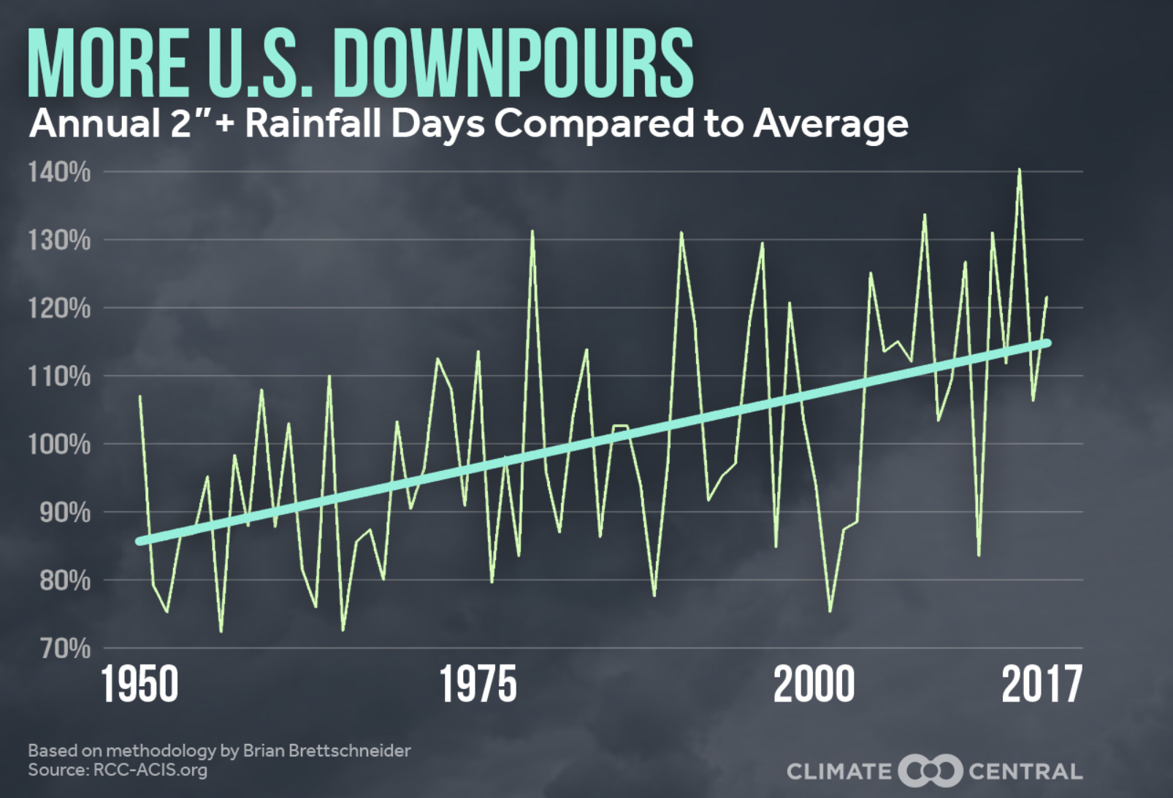
10 – Extreme Events Increasing

Slide 49
10 – Extreme Events Increasing

Slide 50
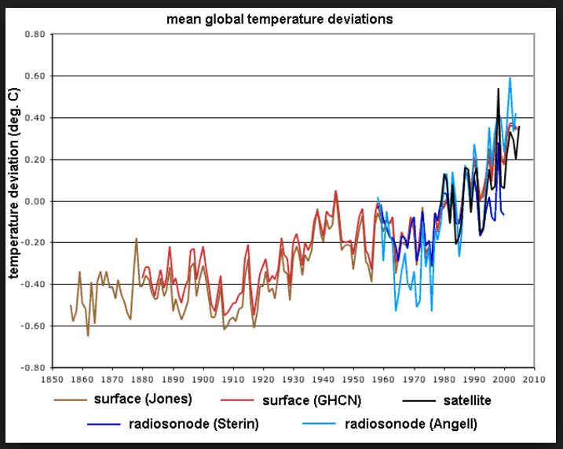
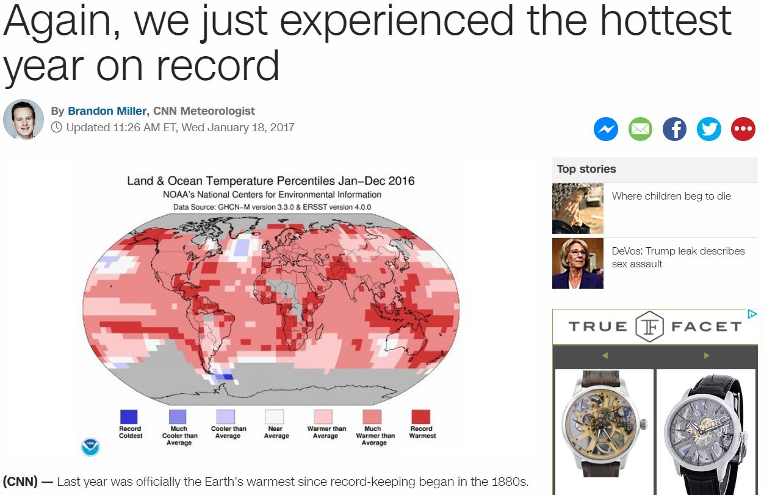
Ken’s Motivation –
Uninspiring Visualizations

Slide 51
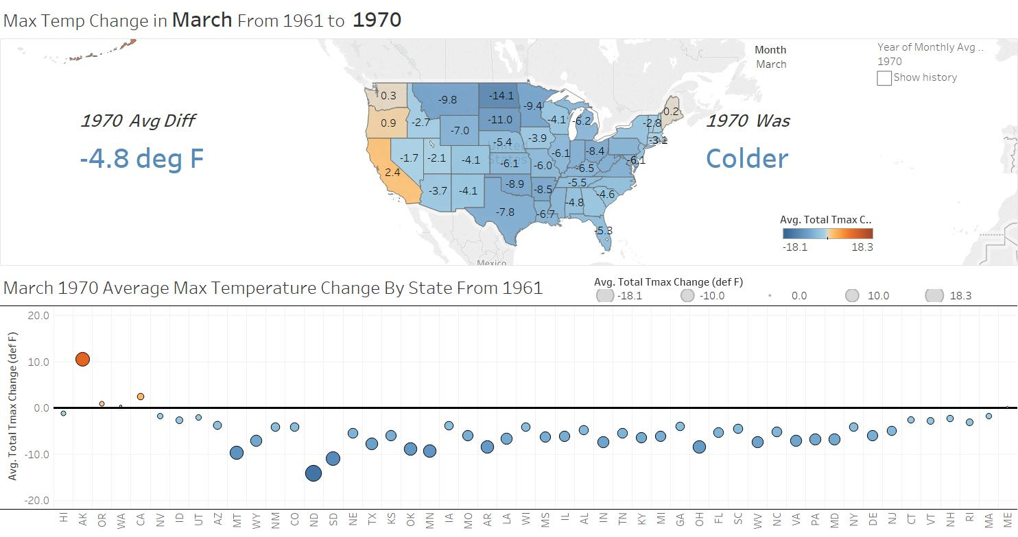
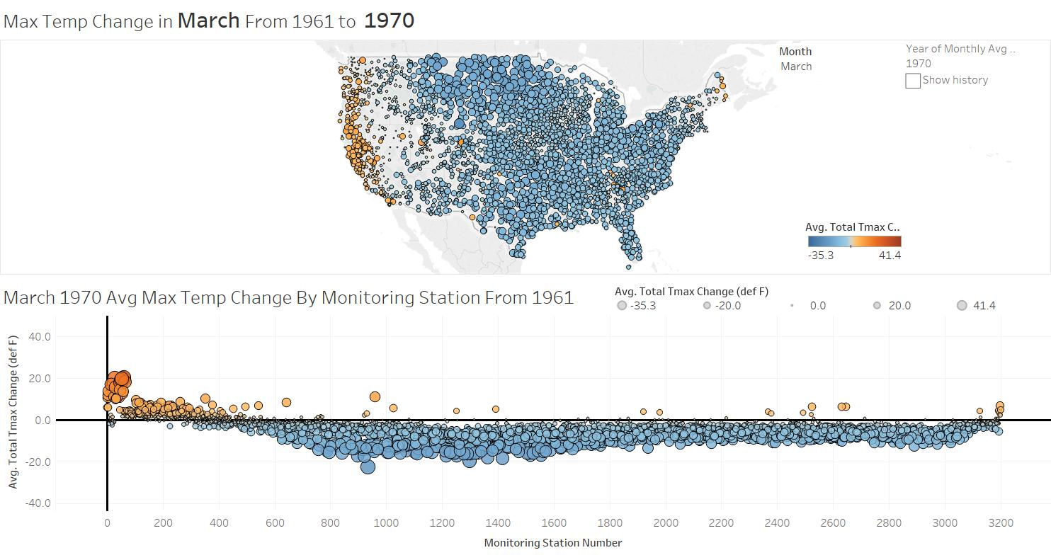
I want to visualize the changes using data

Slide 52
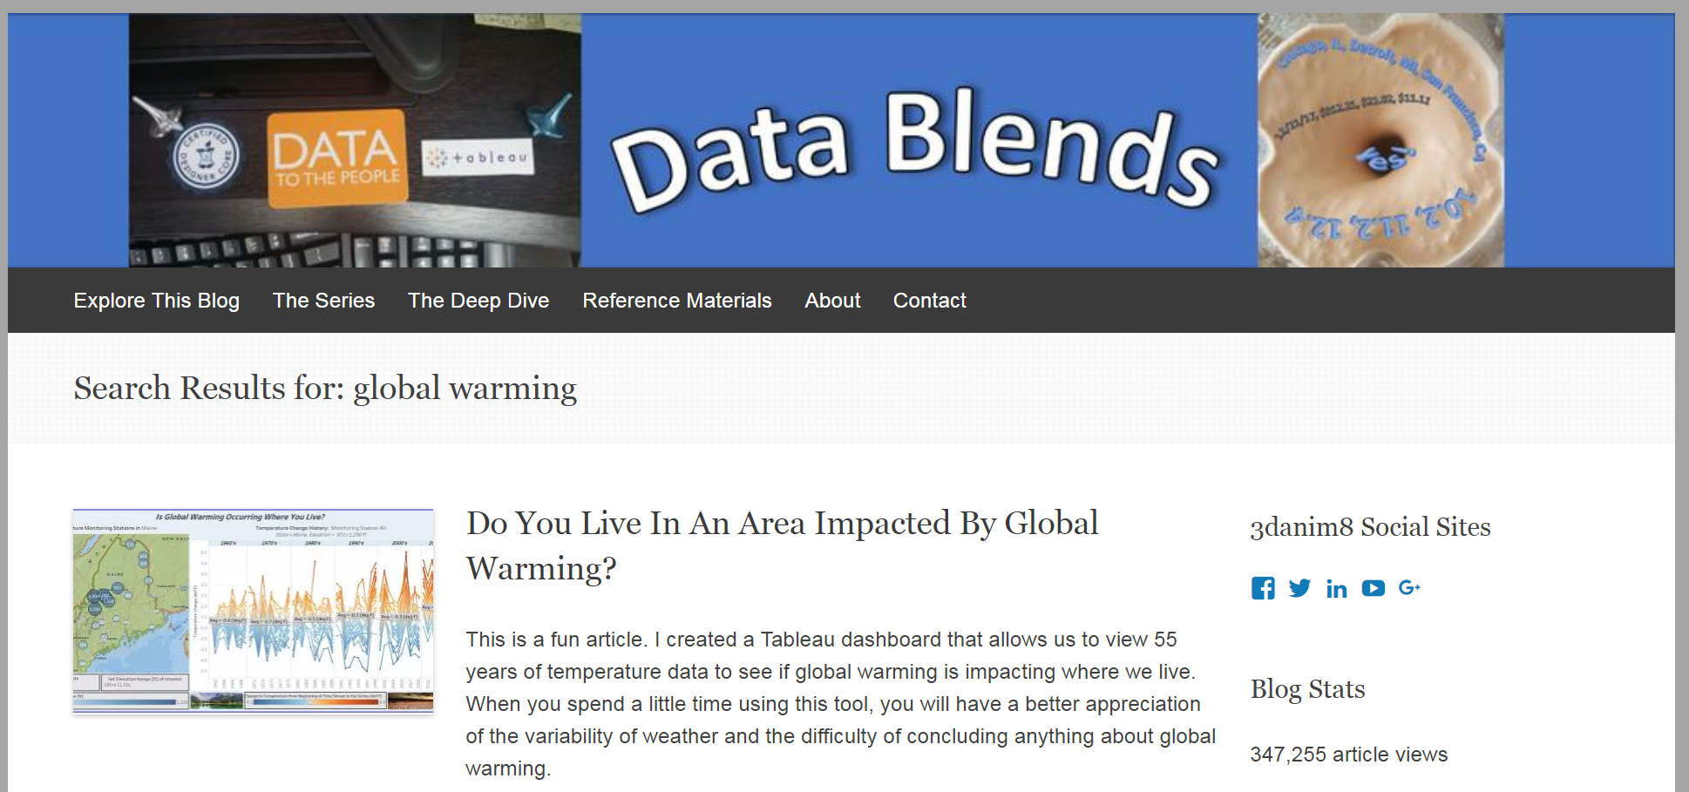
Published Materials
3danim8’s Blog Is
Now Datablends.us

Slide 53
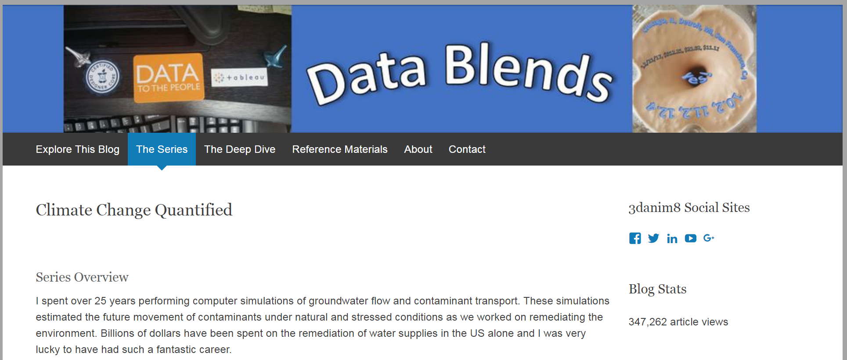
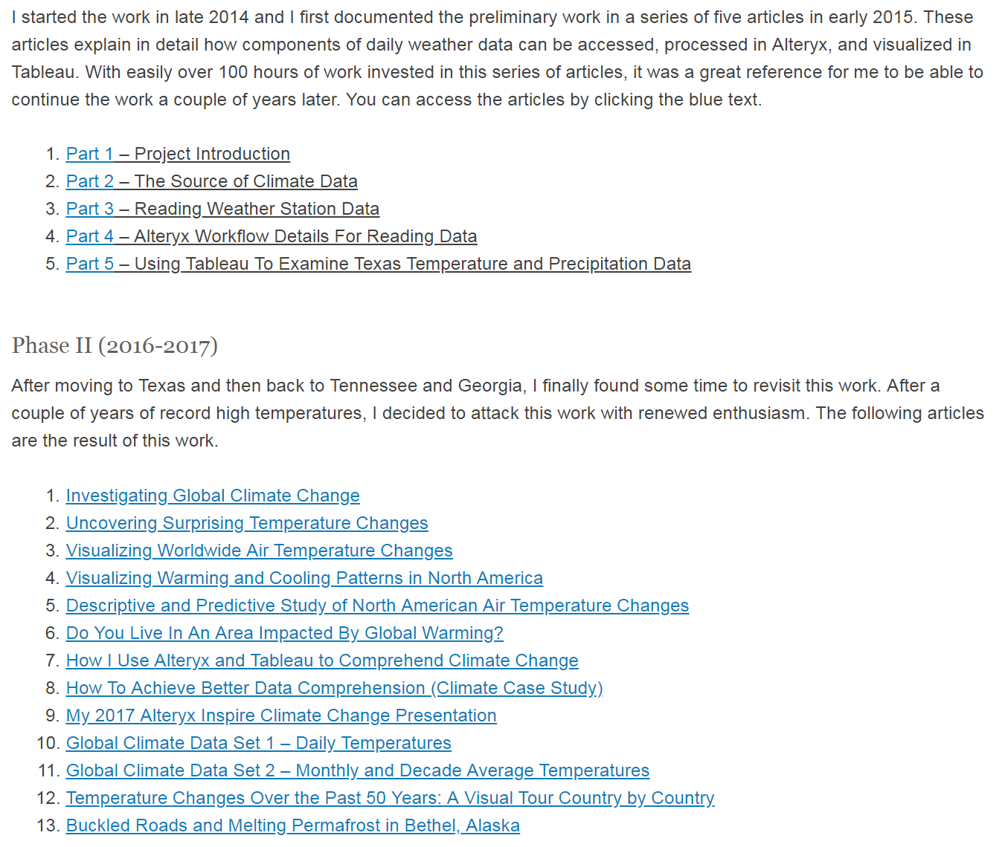
Published Materials

Slide 54
Data Source
Data Source – The Global Historical Climatology Network
Daily climate data
25 Gigabytes in compact format
100,818 monitoring stations world-wide
Data goes back to 1700’s in some countries

Slide 55
GHCN – Global Historical Climatology Network

Slide 56
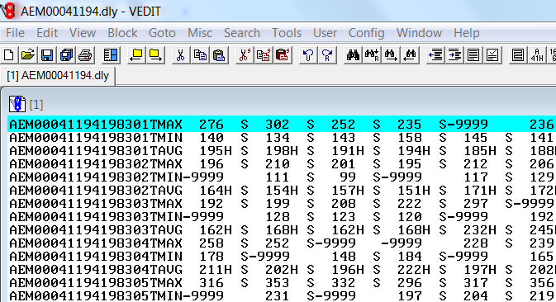
A Sample of the Native, Compact Daily Data Format
A Sample of the Native, Compact Daily Data Format
This data isn’t exactly easy to work with!

Slide 57
Data Preparation Via Alteryx
This work would not exist without Alteryx
The data processing methodology has been described in detail in this article
The data has been processed with three generations of workflows, with unique results achieved

Slide 58
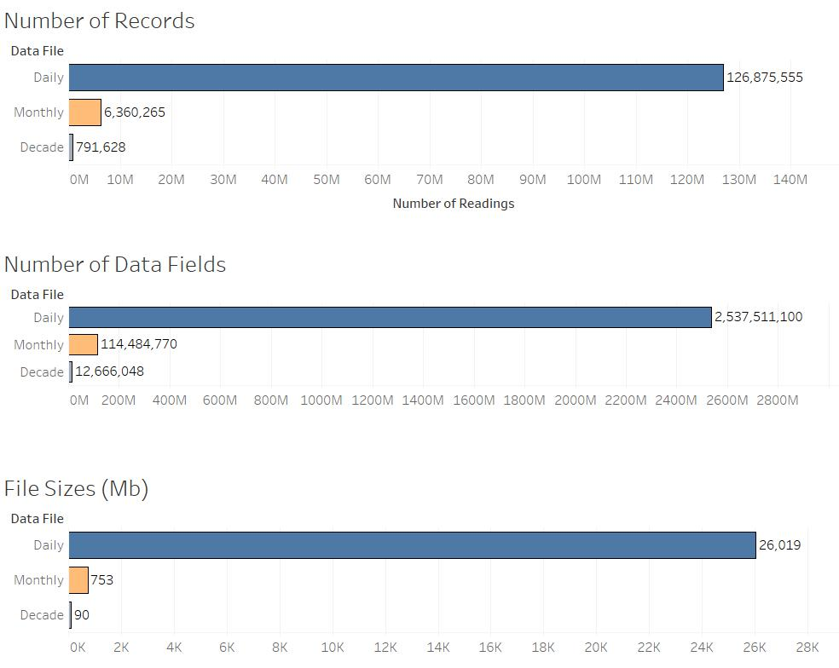
Data Overview
12,181 Monitoring Stations Processed

Slide 59
Daily Data Sample

Slide 60
Monthly Data Sample

Slide 61
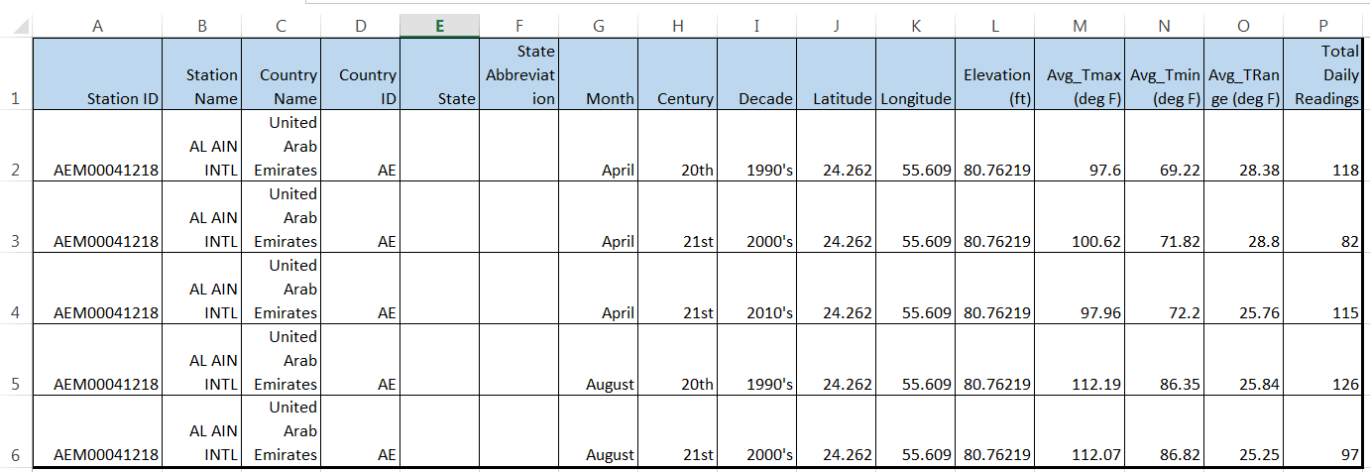
Decade Data Sample

Slide 62
>100,000 Monitoring Stations Over Time

Slide 63
Daily Data – Over 280,000 records for March In NB
NB shows intense March heating from 1960’s to 2010’s

Slide 64
Monthly Data – Can be shown for any station
This California station shows larger Tmin increase compared to Tmax

Slide 65
Worldwide Data Visualization
>5,400 monitoring stations

Slide 66
Nebraska Temp Increases Over Decades
NB monitoring station shows heating

Slide 67
Worldwide Heating 1960’s to 2010’s
>5,400 monitoring stations
March = 3 deg F

Slide 68
Worldwide Heating 1960’s to 2010’s
>5,400 monitoring stations
March = 3 deg F

Slide 69
Temperature Changes WRT to Latitude

Slide 70
Equatorial Temperature Changes

Slide 71
Mid-Latitude Temperature Change

Slide 72
Above Arctic Circle Temperature Changes

Slide 73
Change In March from 1960’s to 2010’s

Slide 74
Change In May from 1960’s to 2010’s

Slide 75
US Change In March from 1960’s to 2010’s

Slide 76
March Nebraska Heating 1960’s to 2010’s

Slide 77
March Colorado Heating 1960’s to 2010’s

Slide 78
March S. Dakota Heating 1960’s to 2010’s

Slide 79
March Kansas Heating 1960’s to 2010’s

Slide 80
Patterns of Heating and Cooling

Slide 81
Closing Remarks
This work is a labor of love
Eventually people will take notice of this work and will share the knowledge it contains
Thanks for listening and subscribe to my blog if you want to follow the story as it continues to unfold

Slide 82
Data Preparation Notes
The Alteryx workflows shown in the next series of slides were used to process the temperature and precipitaton data.

Slide 83
Alteryx Configuration For Reading Compact Daily Data

Slide 84
Data Preparation Via Alteryx

Slide 85
Data Preparation Via Alteryx

Slide 86
Data Preparation Via Alteryx

Slide 87
Data Preparation Via Alteryx

Slide 88
Data Preparation Via Alteryx

Slide 89
Data Preparation Via Alteryx

Slide 90
Data Preparation Via Alteryx

Slide 91
Data Preparation Via Alteryx

