Slide 1
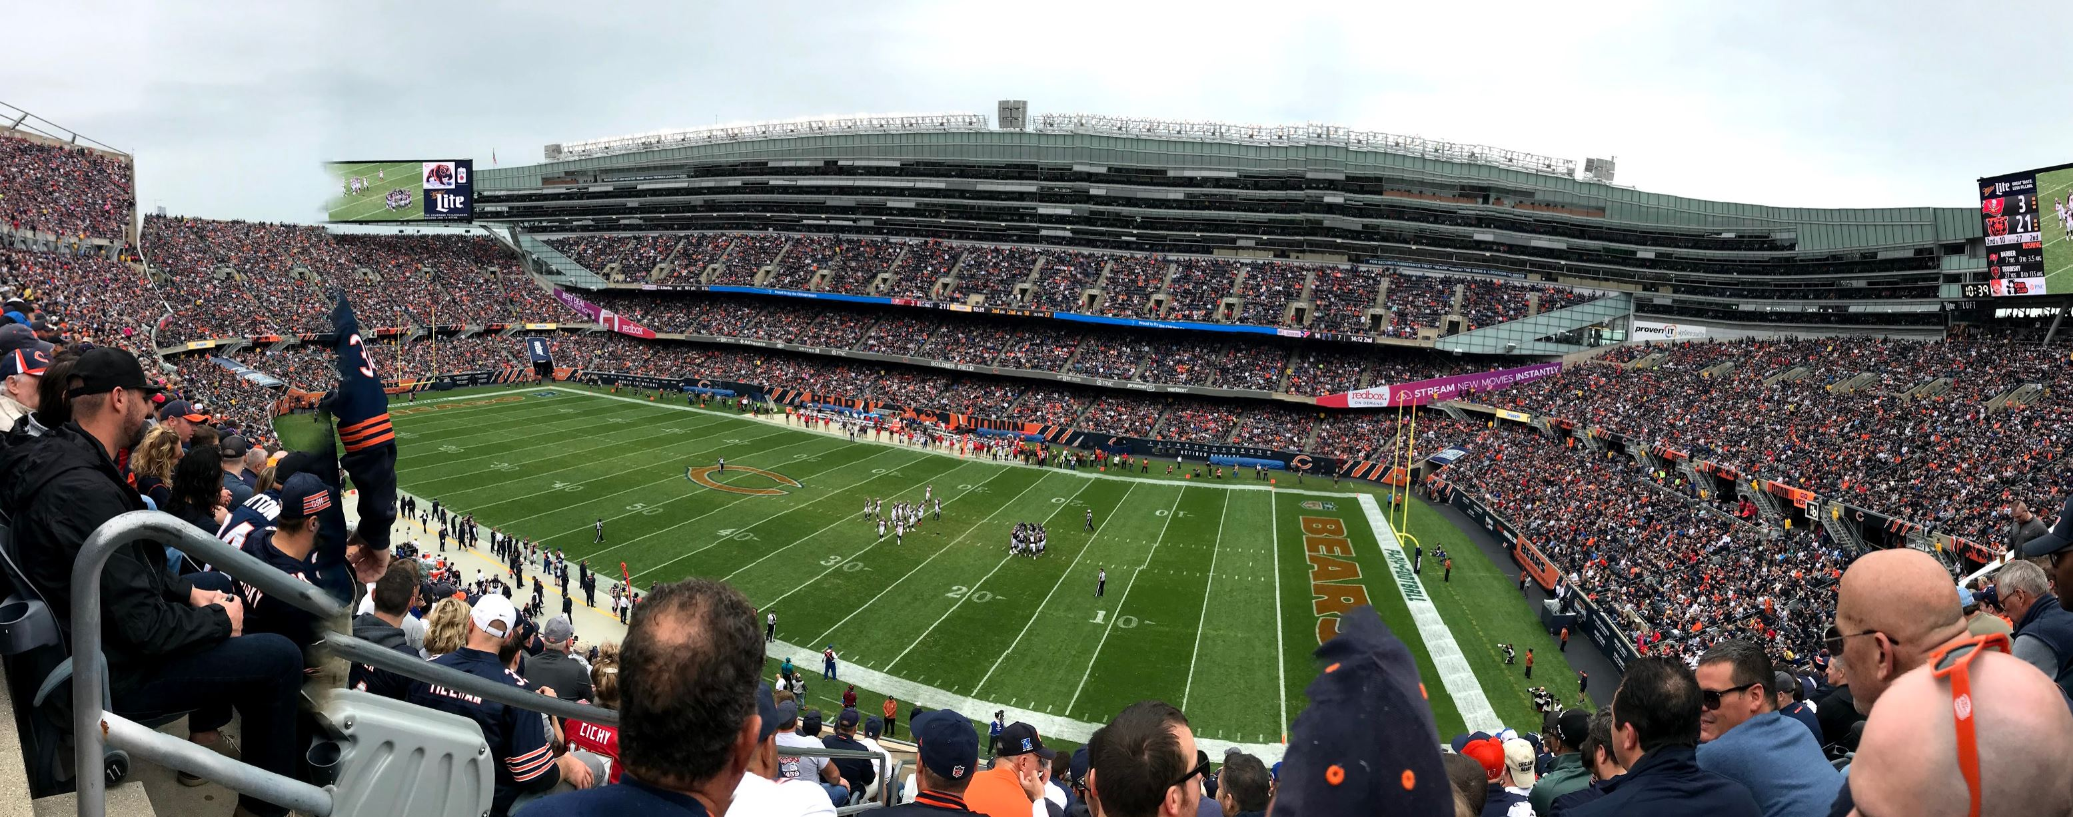

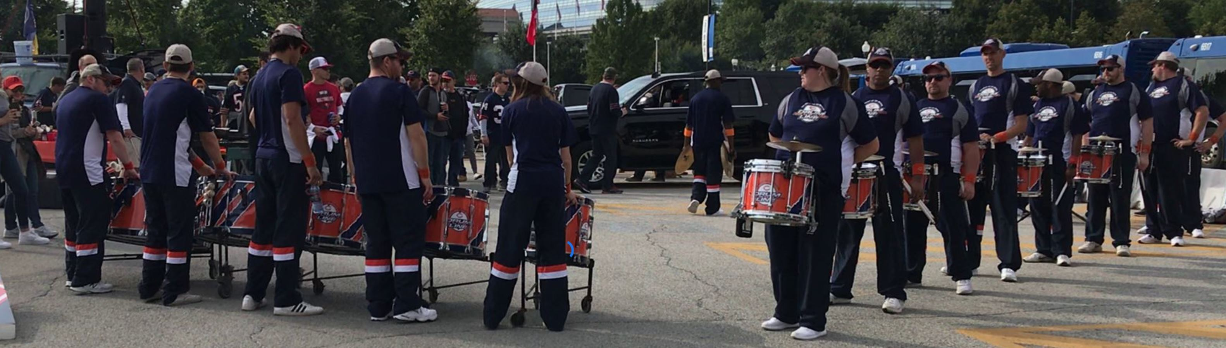

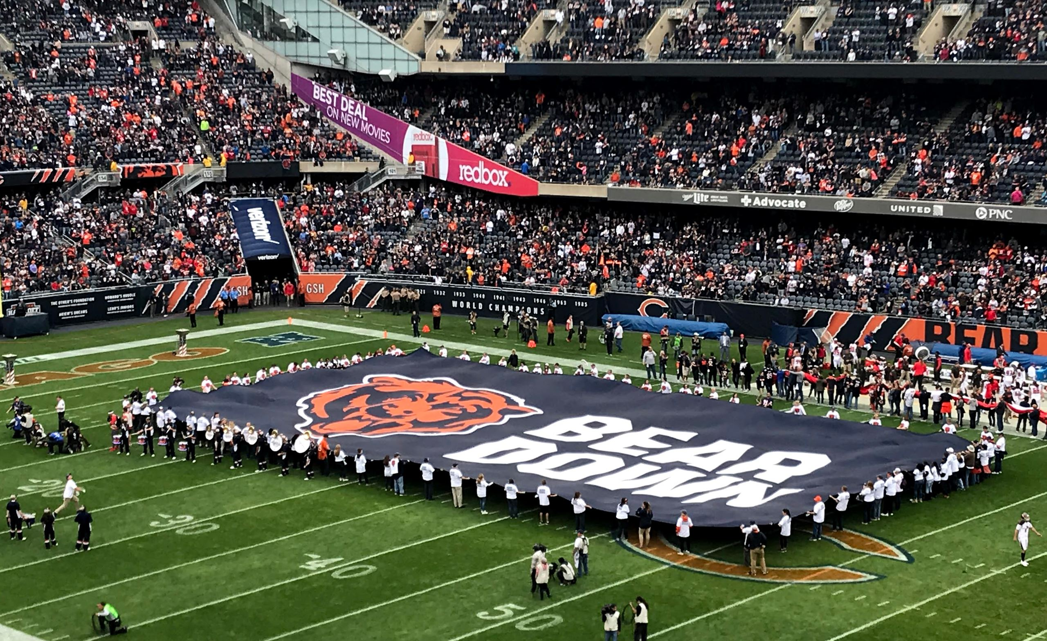
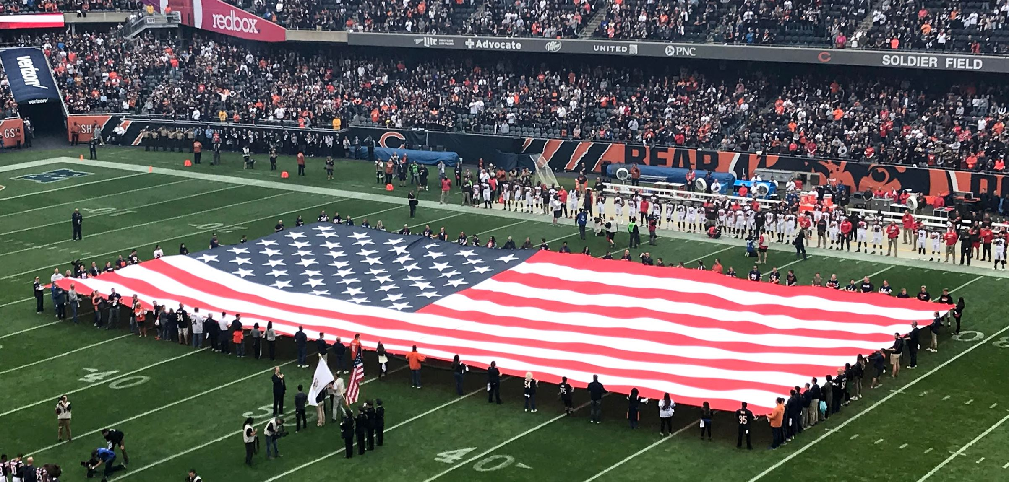
Using Tableau To Understanding How Speed Leads to NFL Success
Ken Black | Apr 30, 2019
https://datablends.us

Slide 2
Opening Remarks
I have been given permission from the NFL to give this presentation
The data provided to me, however, is propriety and I am not allowed to show examples of it
The work I completed was for a competition.
I had limited time to do the work.
I worked about 20 hours on this project during the holiday season of 2018.
I had to sneak this work in whenever possible because …

Slide 3
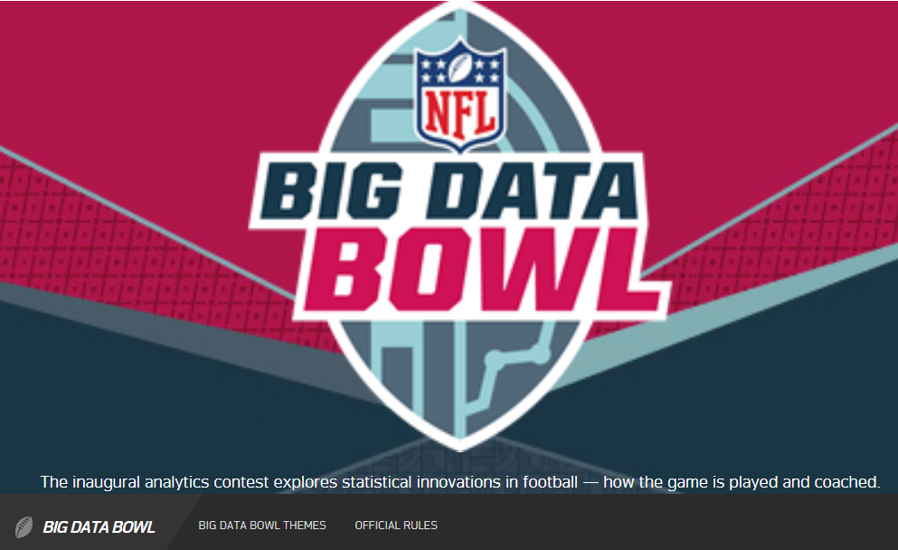
In Late 2018, the NFL Had a Competition Called The

Slide 4
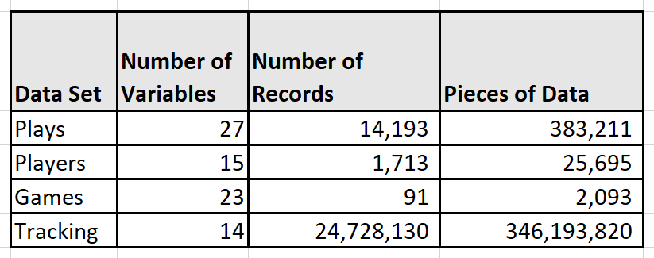
The NFL Supplied Real Game Data To The Competitors
Play data: Play-level information from each game.
Player data: Player-level information from players that participated in at least one play.
Game data: Each game from the first 6 weeks of the 2017 season.
Tracking data: Player tracking data from game.
With nearly 350M pieces of data, this was a big data challenge in a limited time frame.
Data supplied in R format.
Of course, I used Alteryx and Tableau!

Slide 5
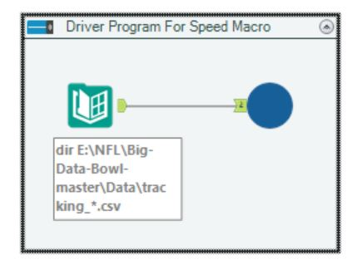
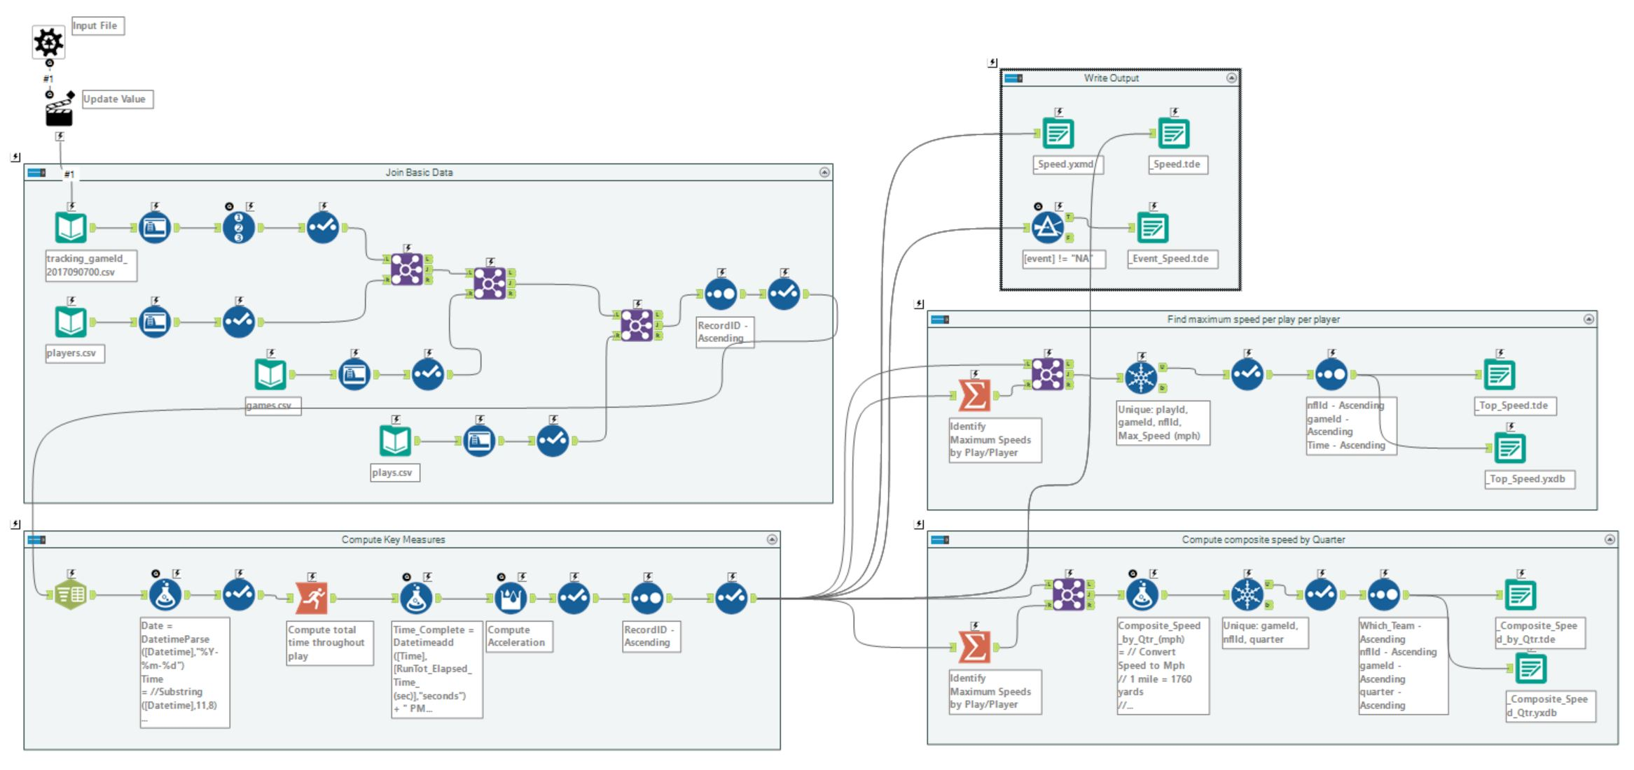
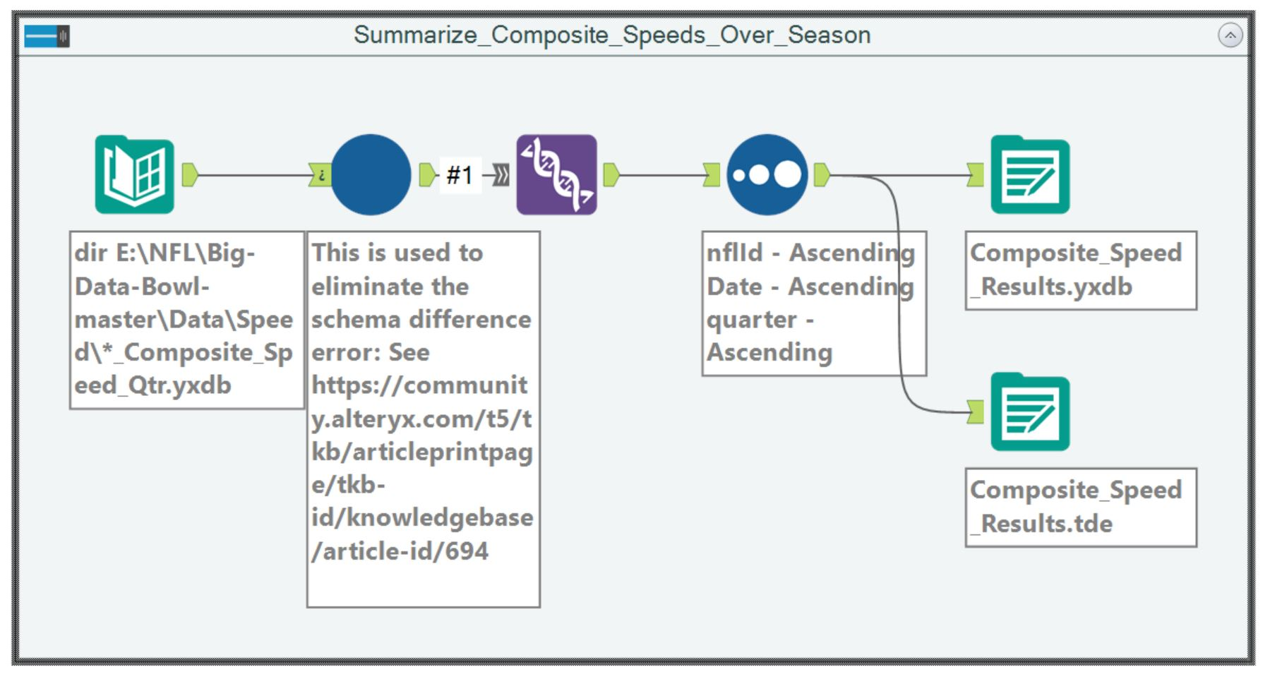
Computing The Importance of NFL Speed
Key Concepts Used:
Multiple levels of detail
Various levels of aggregation
Time series analysis
Step 1 – Use Alteryx to process the supplied NFL game data
Batch macros easily crunch all the game data
Step 2 – Use Tableau to visualize how speed creates success in games

Slide 6
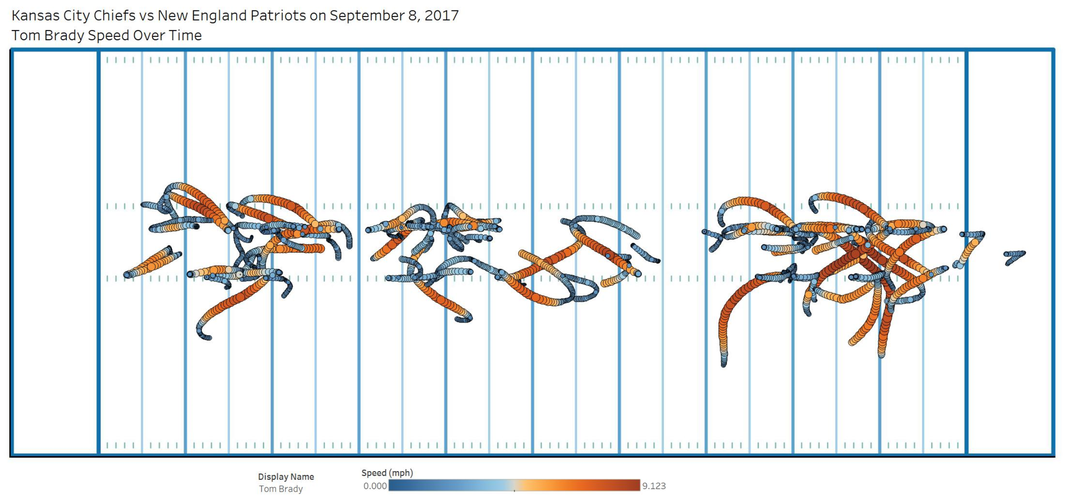
Tableau Visualizes The Importance of NFL Speed
About 12 different types of visualizations will be shown to demonstrate how the data can be used to understand speed and success

Slide 7
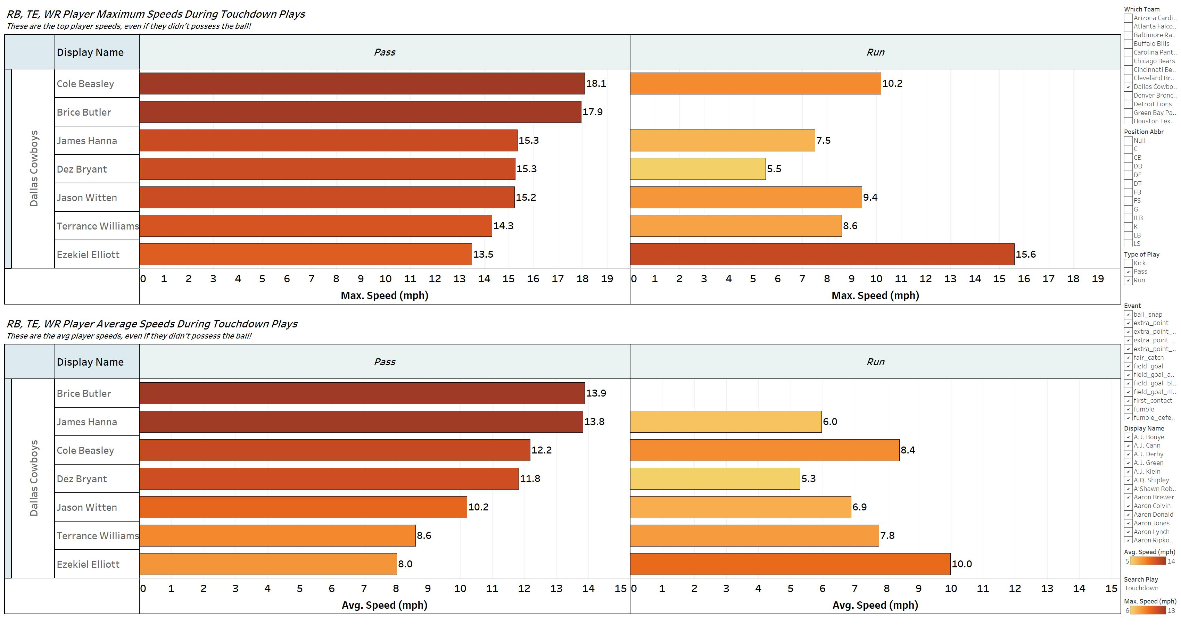
Example 1: Max And Average Speeds During Touchdown Plays

Slide 8
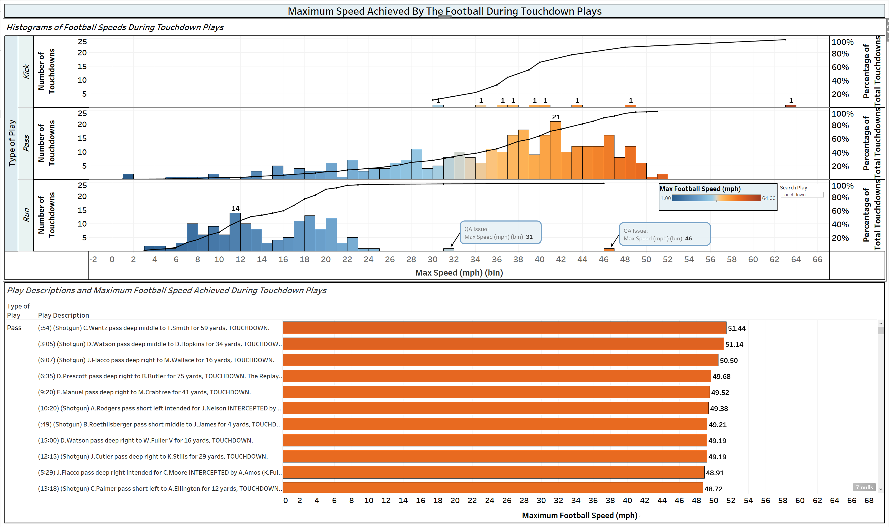
Example 2: Understand The Speed Of The Football During Touchdowns

Slide 9
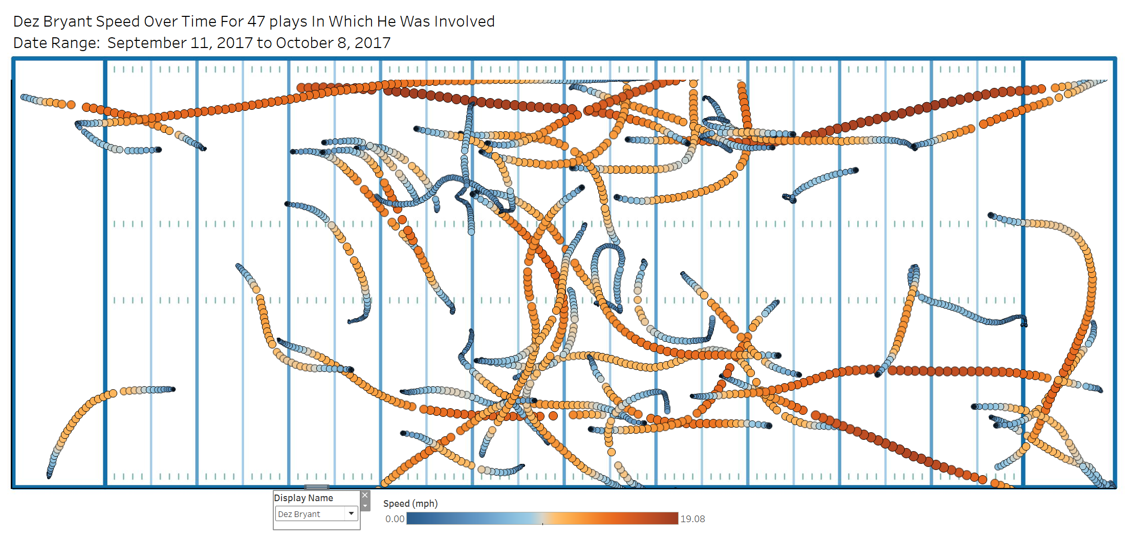
Example 3: Track How A Player Uses Speed During Actual Plays

Slide 10
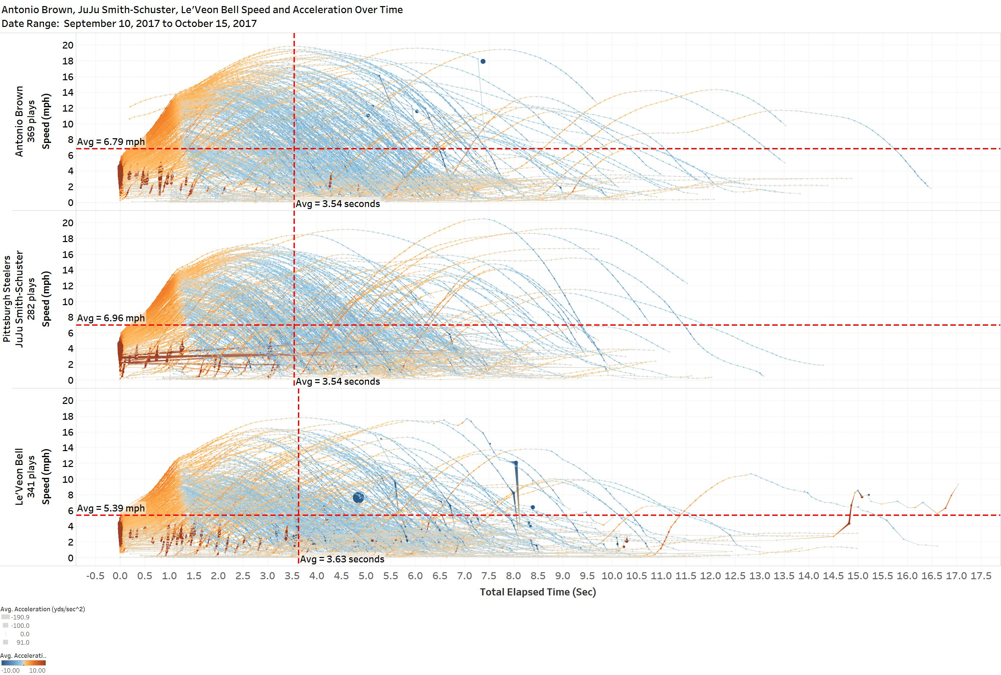
Example 4: Compare Players To Understand Their Speed Profiles

Slide 11
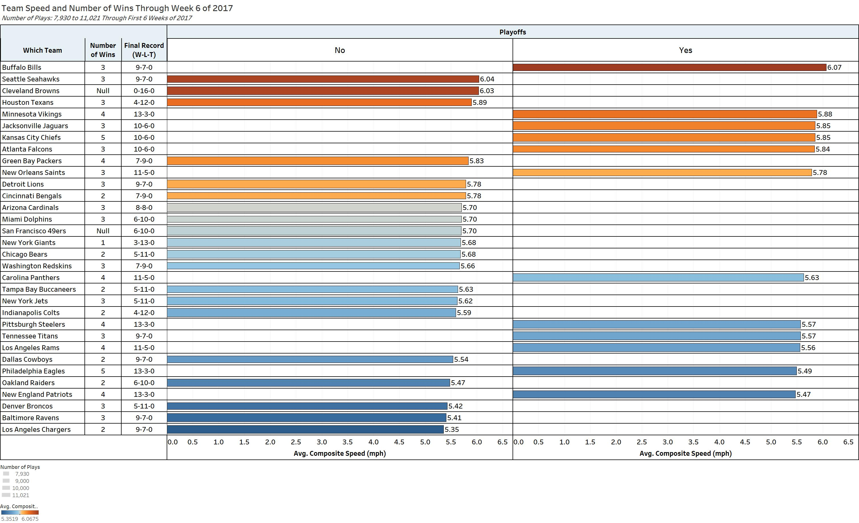
Example 5: How Does Team Speed Relate To Success?
Insights:
Of all 2017 playoff teams, the two slowest teams (Eagles and Patriots) made it to the Superbowl.
Both of these teams were also among the slowest six teams in the league.
Conversely, six of the ten fastest teams overall made it to the playoffs.
Conclusion: Overall team speed in the early season is not a good indicator of post-season success.

Slide 12
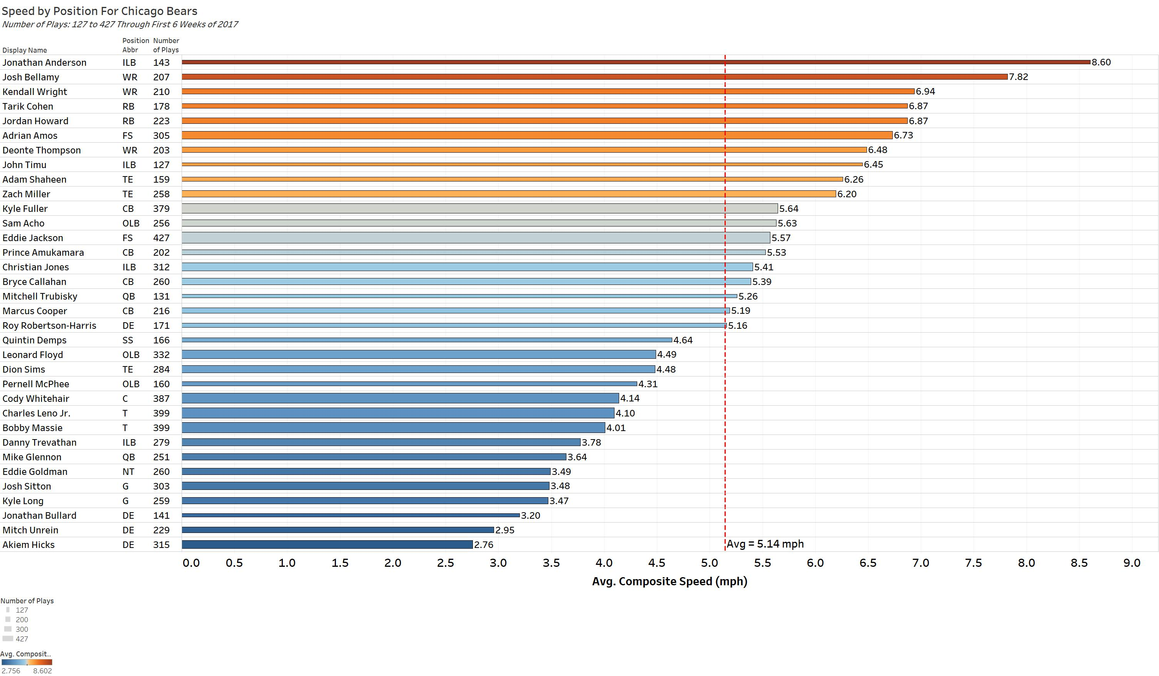
Example 6: How Does Player Speed Relate To Team Success?
Insights:
The Chicago Bears made a jump from last place in 2017 to first place in 2018.
Five of their top eight fastest players in 2017 were not on the team in 2018.

Slide 13
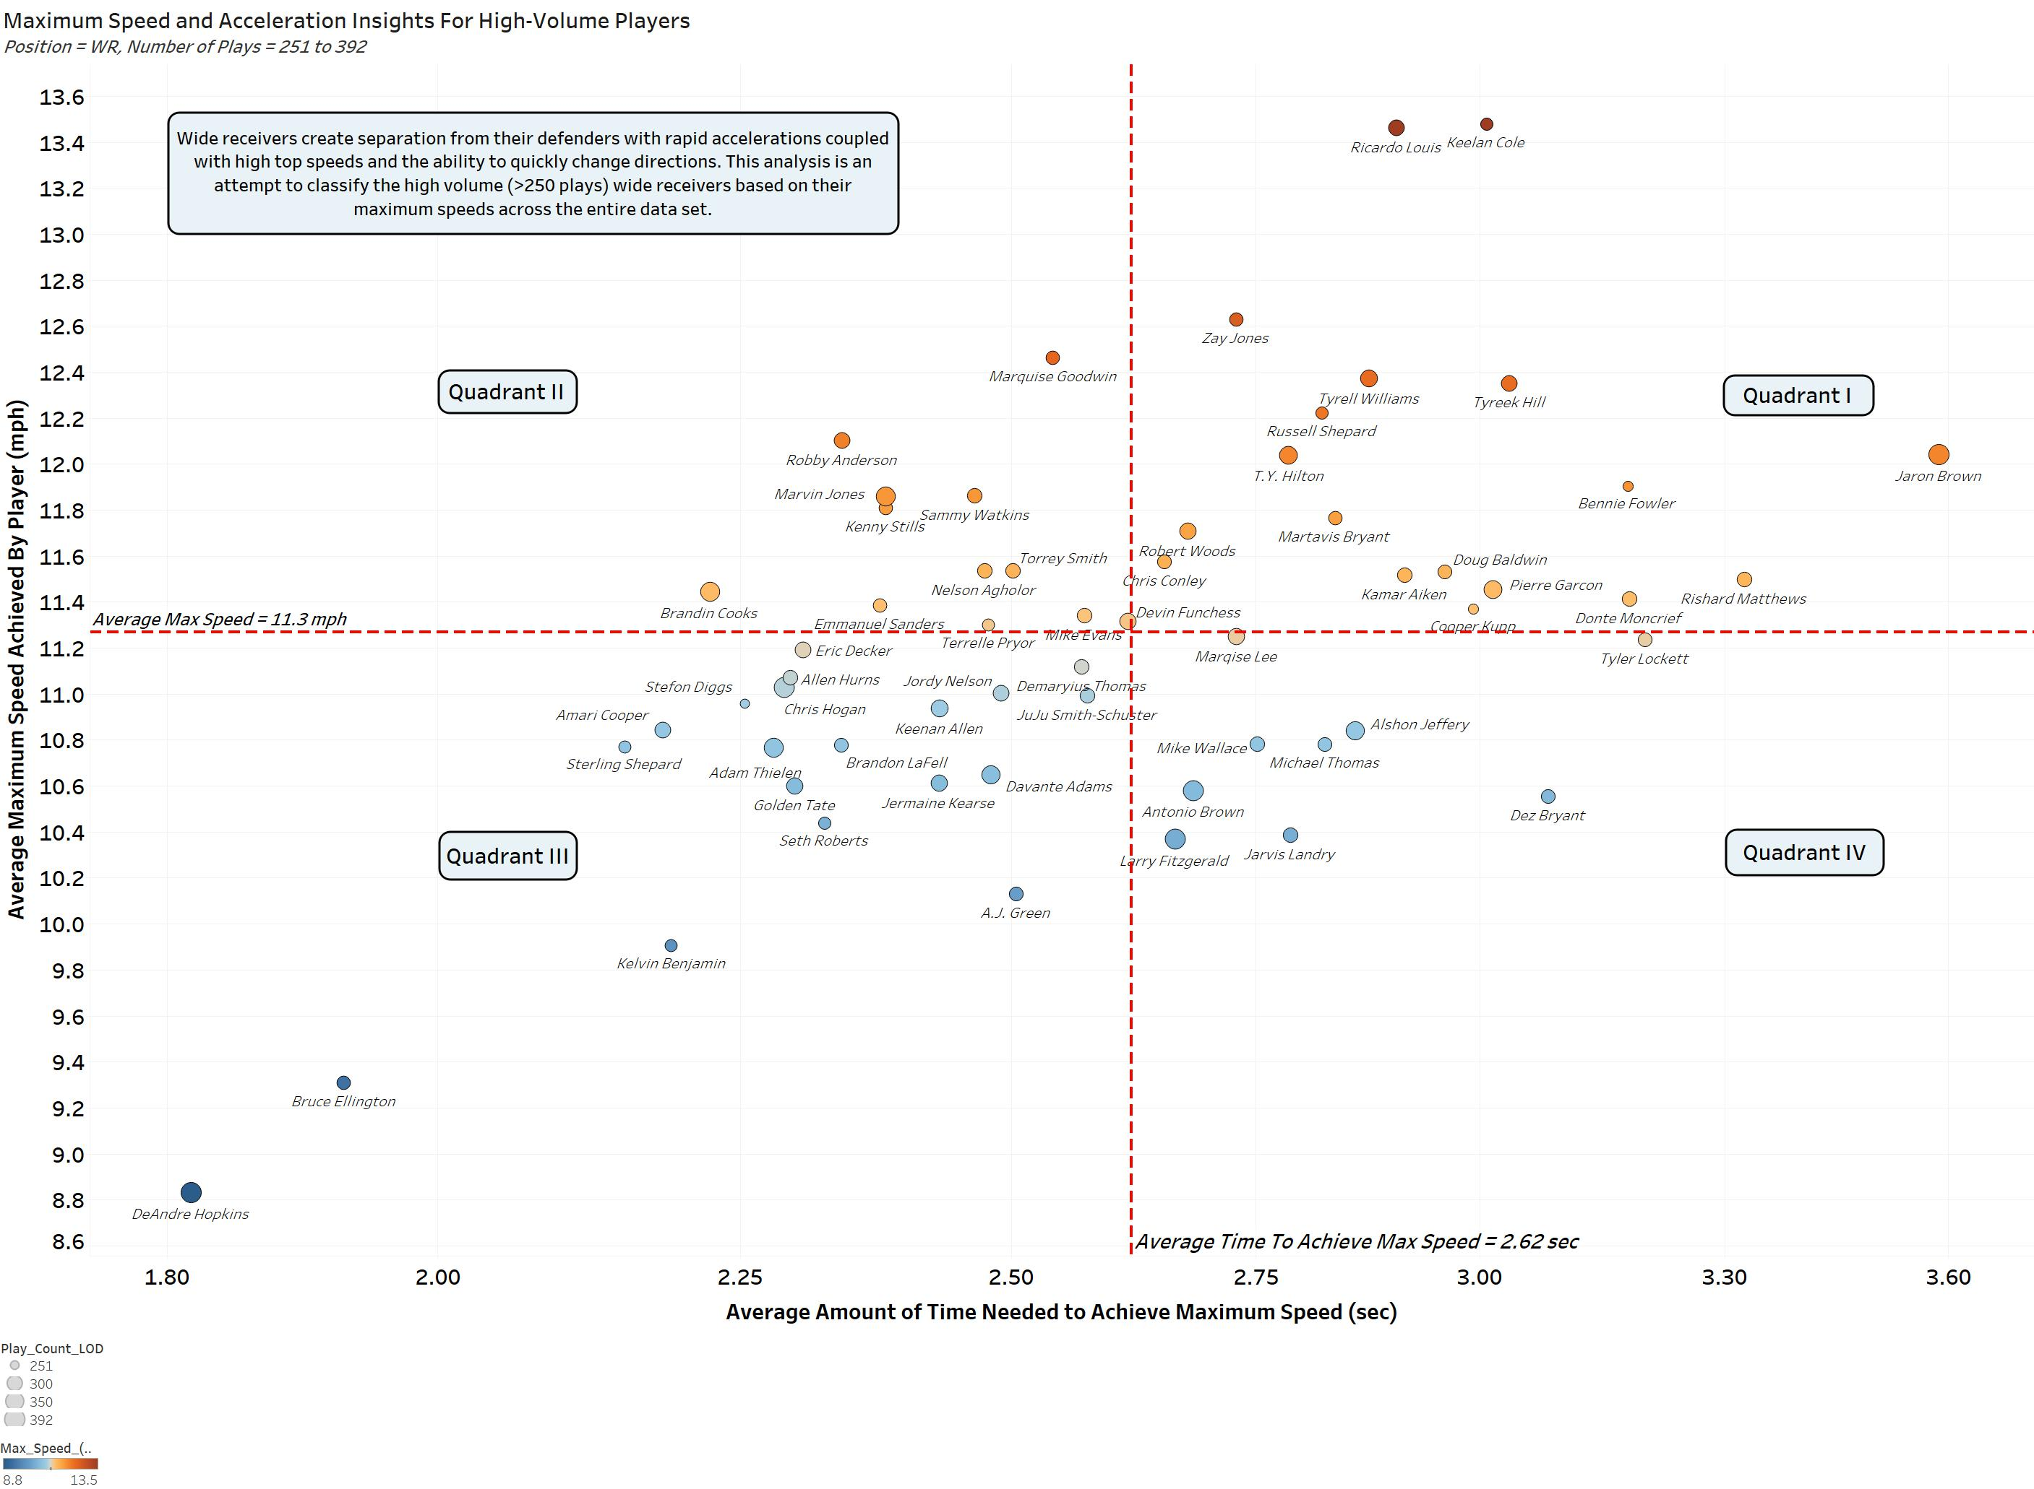
Example 7: How Does Wide Receiver Speed Relate to Production?
Insights:
This graphic relates maximum speeds obtained during all their plays to the times needed to achieve the max speeds (a measure of acceleration).
These aggregated measures are very informative for these high-volume players.
Quadrant I – Speed burners, downfield threats but only three or four superstars (e.g., T.Y. Hilton).
Quadrant II – High speed and quickness receivers also known as downfield threats (e.g., B. Cooks).
Quadrant III – Slot receivers, great quickness, elusiveness and dependability (e.g., A. Thielen) .
Quadrant IV – All superb number 1 receivers, great dependability but less than average speed (e.g., M. Thomas).
Conclusion – Quick, elusive and deceptively fast players (Q III-IV) are more productive receivers than pure speed players (Q I-II).

Slide 14
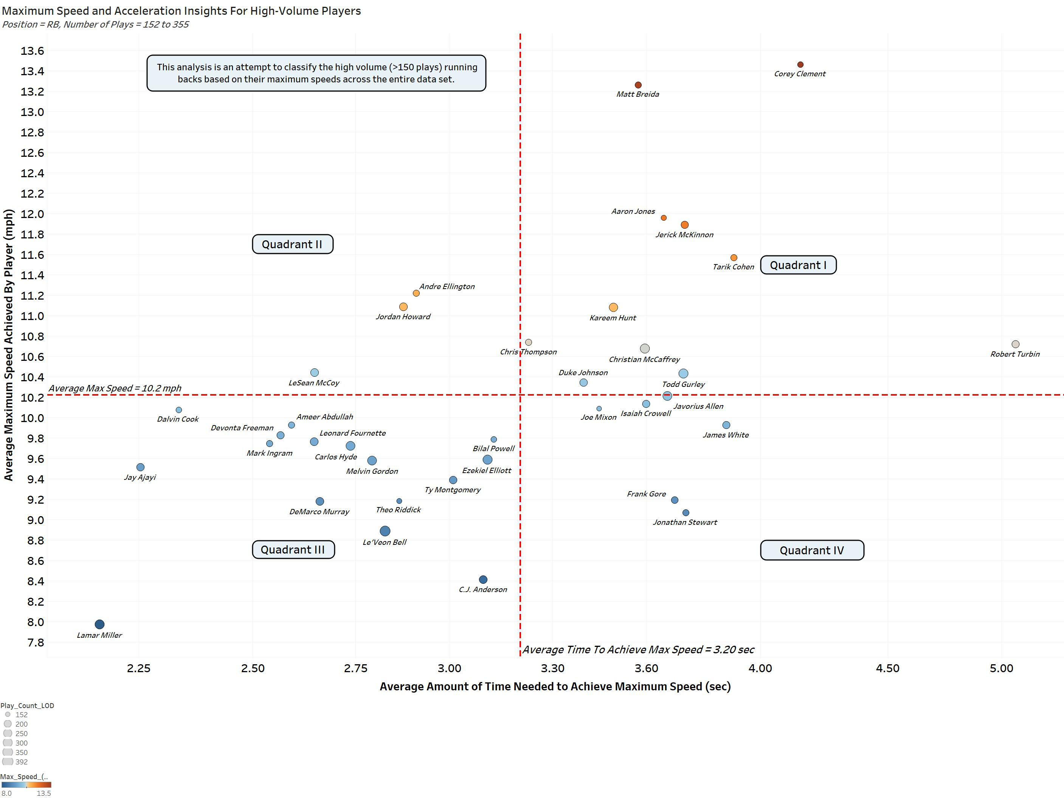
Example 8: How Does Running Back Speed Relate to Production?
Insights:
The results for high-volume running backs have also created some interesting insights.
Quadrant I – Speed burners, also known as explosive playmakers, that are multi-dimensional threats because they can catch passes and run the ball (e.g., T. Cohen) .
Quadrant II – High speed, quick, and strong. Game breaking abilities (e.g., J. Howard).
Quadrant III – Power players having excellent quickness and elusive moves (e.g., L. Bell).
Quadrant IV – Power players that lack superb quickness but still are very productive with long careers (e.g., F. Gore).
Conclusion – Two primary categories of highly productive players emerged from this analysis: explosive playmakers with speed (Q I) and quick, powerful backs (Q III).

Slide 15
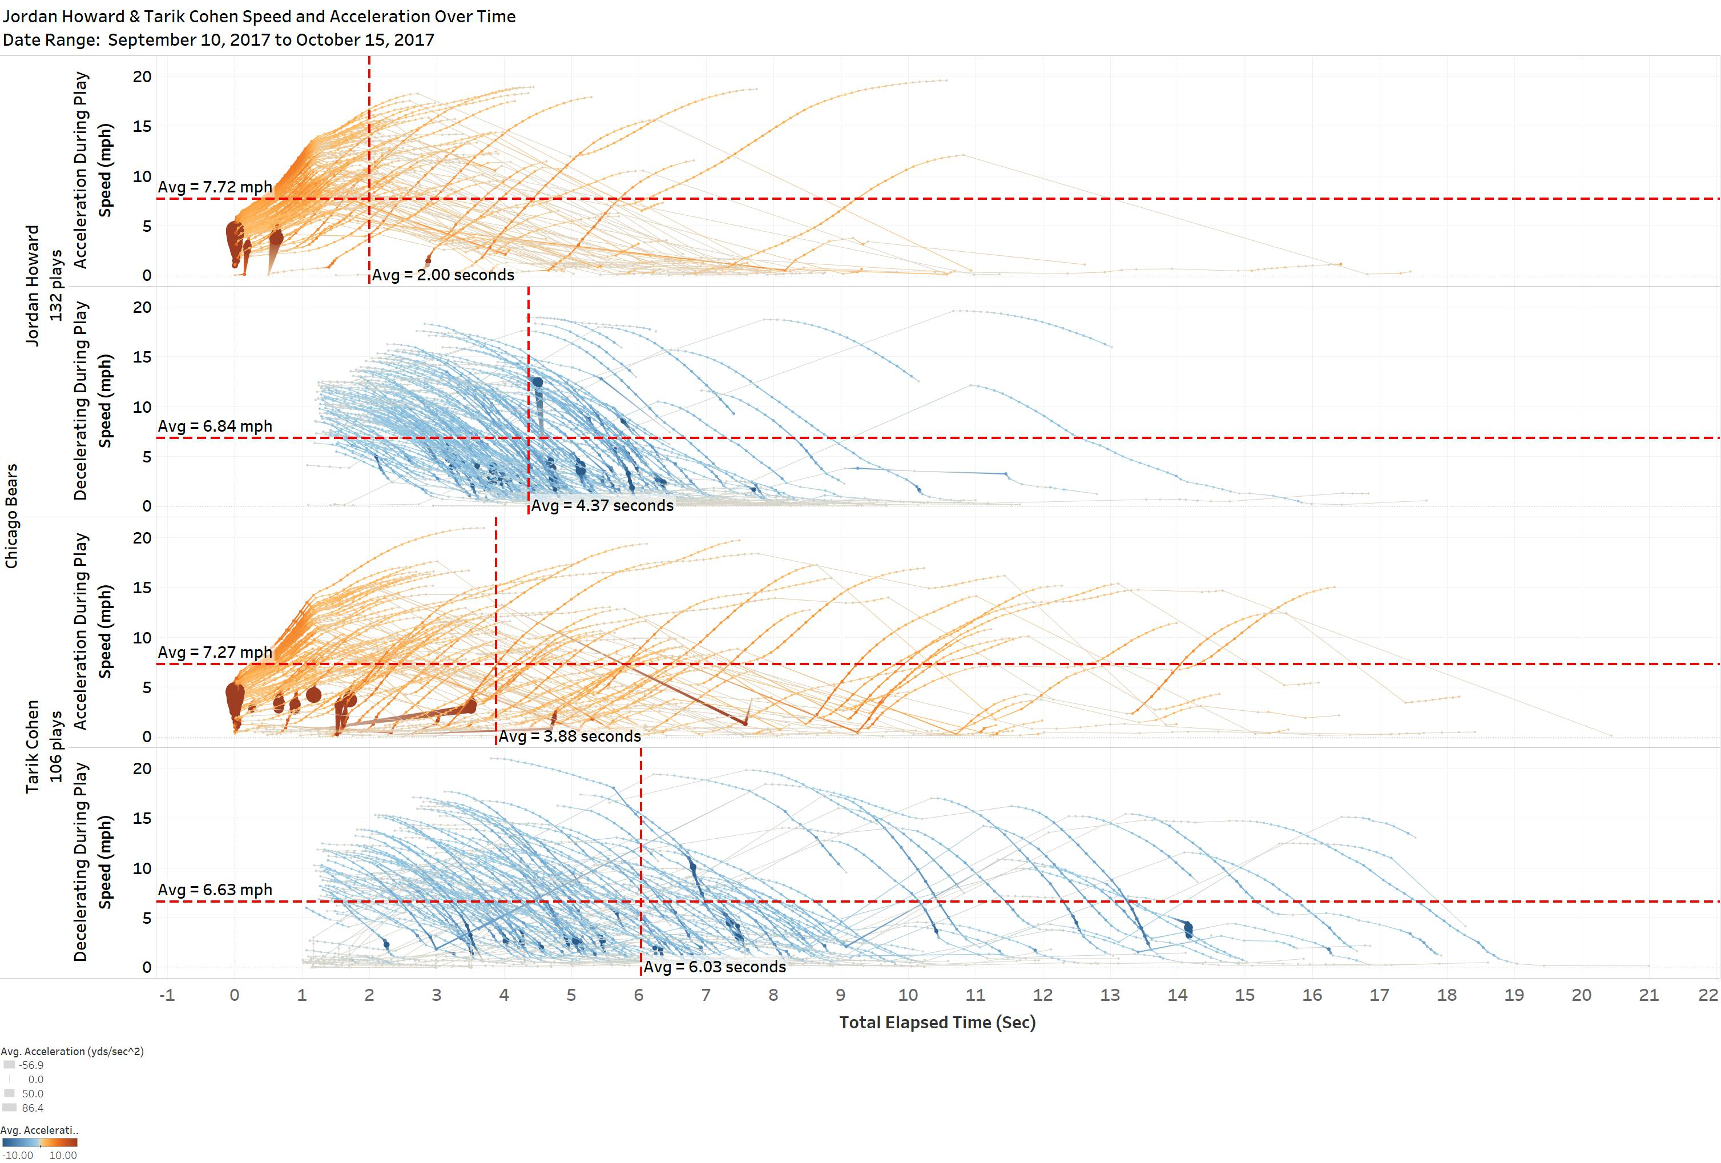
Example 9: How Does Acceleration and Speed Influence Production?
Insights:
This analysis compares a power running back (Jordan Howard) to an elusive scat back (Tarik Cohen) of the Chicago Bears.
The player speed profiles are shown for all plays they were actively involved in. The data is broken into acceleration and deceleration phases of the plays.
The results were surprising in that Howard not only is fast, he accelerates better than Cohen. This is likely because Cohen was used more as a receiver, with more delayed acceleration phases shown and Cohen can be indecisive at times.
Conclusion – Both players are highly productive in their roles. Jordan Howard exhibits better explosiveness and speed than expected. Cohen is used as a receiver in longer-lasting plays.

Slide 16
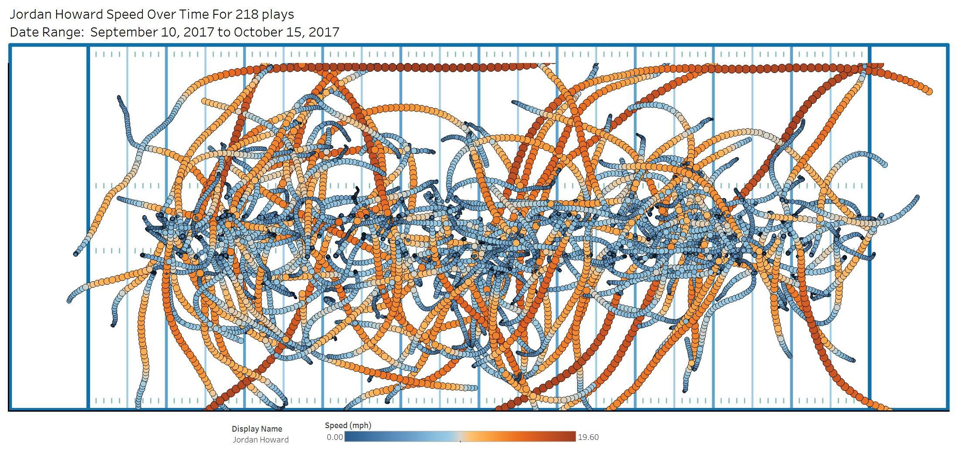
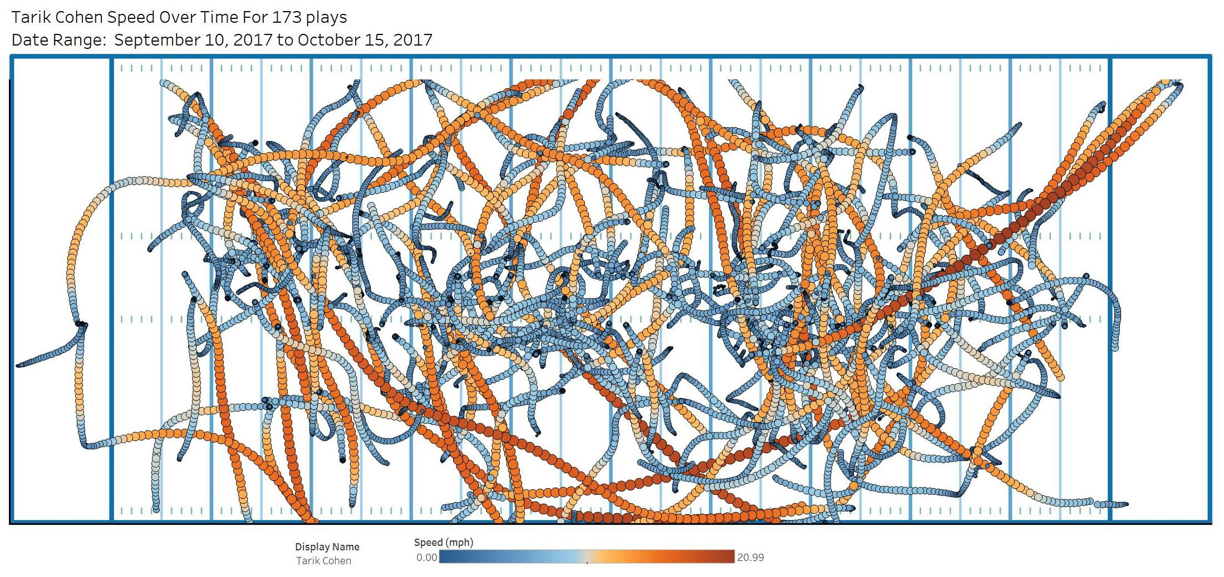
Example 10: How Does Speed and Play Selection Influence Production?
Insights:
This analysis compares a power running back (Jordan Howard) to an elusive scat back (Tarik Cohen) of the Chicago Bears.
The player positions and speed profiles are shown for all plays they experienced, regardless of whether they were ball carriers or receivers.
The results were surprising in that Howard exhibited a lot of speed getting to the sidelines. He also was used to pound the ball between the hashmarks. Cohen, on the other hand, exhibited more chaotic patterns, with a lot of directional changes. There were fewer high-speed plays compared to Howard.
Conclusion – Both players exhibit significant speed and have a lot of diversity in their usage. The play patterns indicate that each player is multi-talented, with game-breaking abilities. Cohen has a higher top speed of 21 mph compared to Howard at 19.6 mph, but that is plenty of speed for both to break long runs.

Slide 17
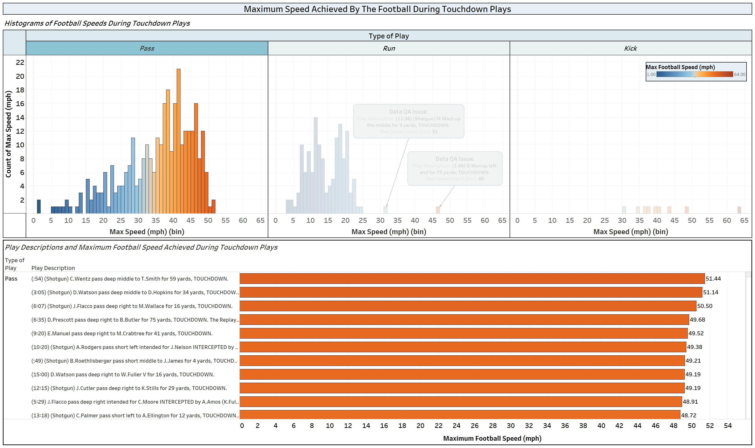
Example 11: How Does The Football Speed Influence Team Success?
Insights:
This analysis investigates the speed of the football during passing touchdowns. Afterall, the football speed is created the quarterbacks!
The maximum passing speed recorded during a touchdown was nearly 51.5 mph on a pass thrown by Carson Wentz.
50% of the touchdown passes occur from 1-30 mph (touch passes), and 50% occur from 30-52 mph (rocket passes).
Conclusion – QBs need a strong throwing arm and the ability to use a soft touch when necessary to create touchdown passes.

Slide 18
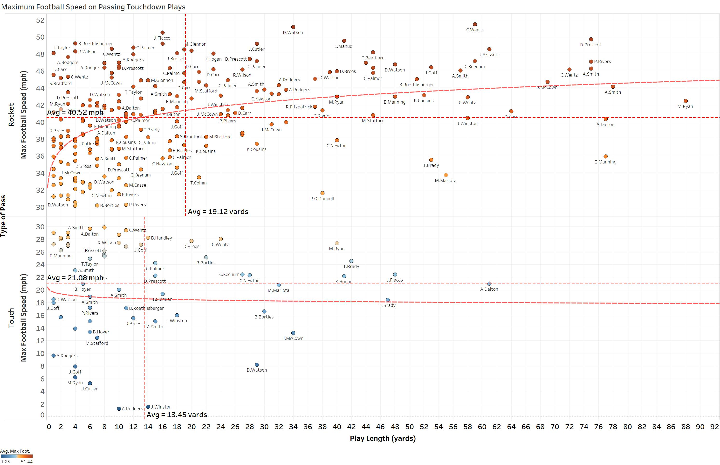
Example 12: How Does Passed Football Speed Influence Touchdowns?
Insights:
Rocket passes have max speeds >30 mph while touch passes are from 0 – 30 mph.
Long touchdowns (> 50 yards) are almost always rocket passes.
50% of passing touchdowns are <10 yards and 75% are <24 yards.
For all QB’s that threw at least 5 touchdowns:
  Derek Carr had the highest average velocity of 43 mph at an average play length of 20.5 yards for 8 TDs.
  Matt Ryan achieved 6 TDs with an average play length of 30 yards at 33 mph.
Conclusion – Great QB’s need to have a strong arm to throw deep, but they also need to use touch on deep throws and high velocities on short throws into tight windows.

Slide 19
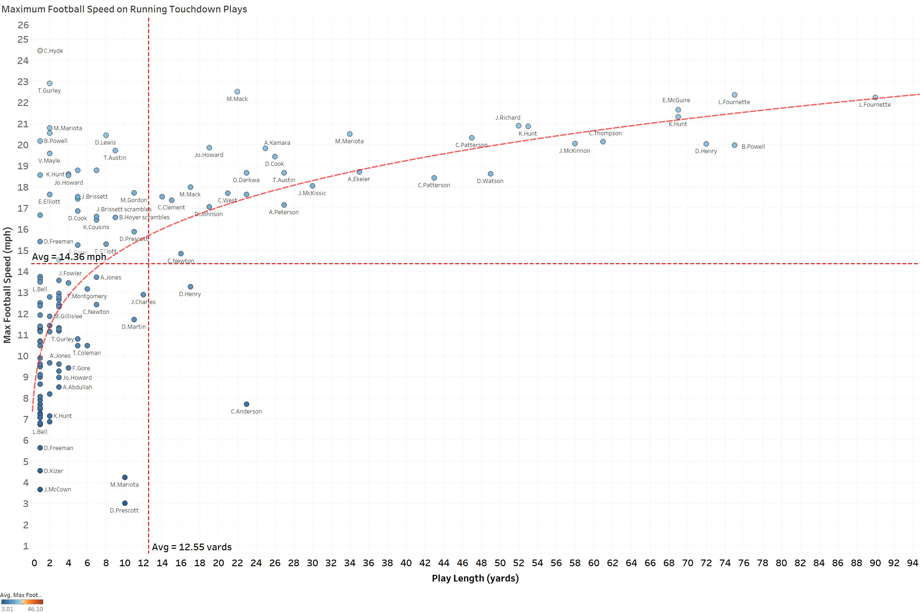
Example 13: How Does Running Football Speed Influence Touchdowns?
Insights:
Top speeds of >17 mph are needed to create long >30 yard running touchdowns.
L.Fournette has a surprising top-end speed for a big, powerful player.
71% of rushing touchdowns are <10 yards.
For all RBs that run for at least 2 touchdowns:
  A cluster of long-distance gainers emerged including C. Patterson, D. Murray, L. Fournette, K. Hunt and others. A larger database of games would be needed to refine the analysis.
Conclusion – For RB’s to achieve long TD’s (>30 yards), they need a top-end speed >17 mph. The faster these players can run, the more likely it is for long TD runs to occur.

Slide 20
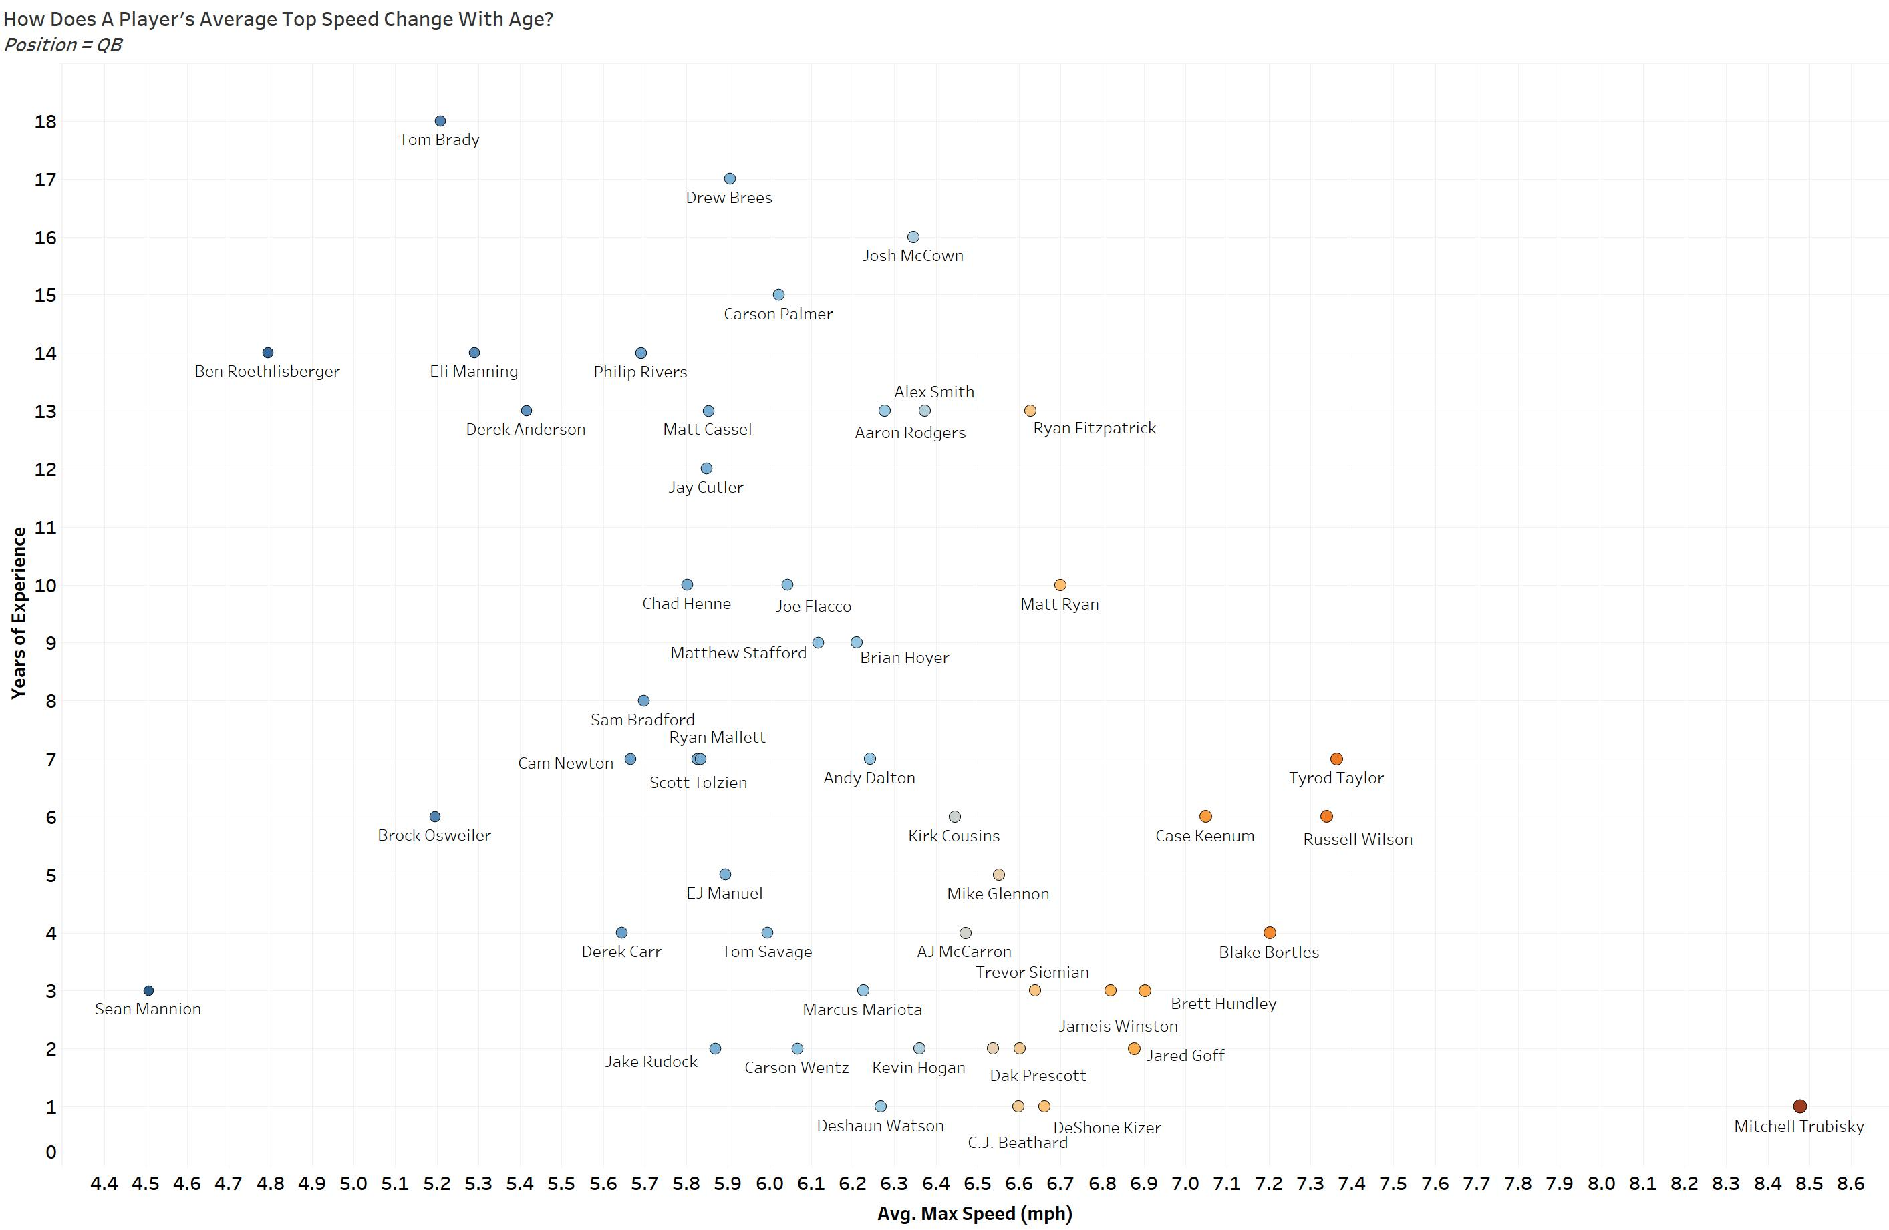
Example 14: How Does QB Speed Change With Age?

Slide 21
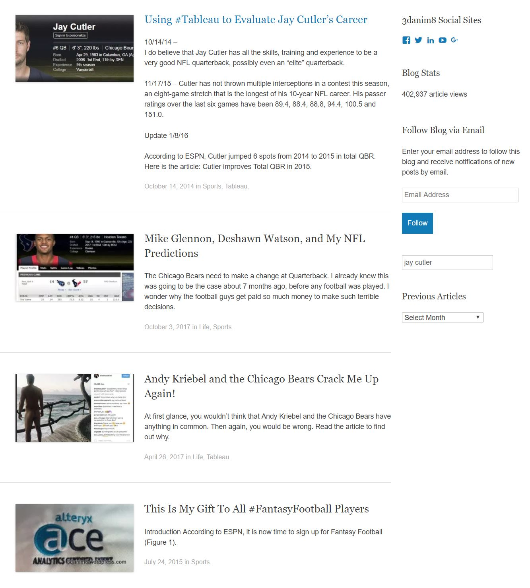
Final Thoughts
There are other insights within this data beyond what I have shown. All the results shown were developed using interactive dashboards for easy exploration and evaluation of teams, players and positions.
Here is another example of data usage:
An Animation of Alex Smith Throwing a 75-Yard Touchdown
For more information on other NFL data assessments
I have completed, please visit:
My analytics blog: Data Blends
Thank you to the NFL for allowing me the opportunity
to access and use this data!

